Slide 1
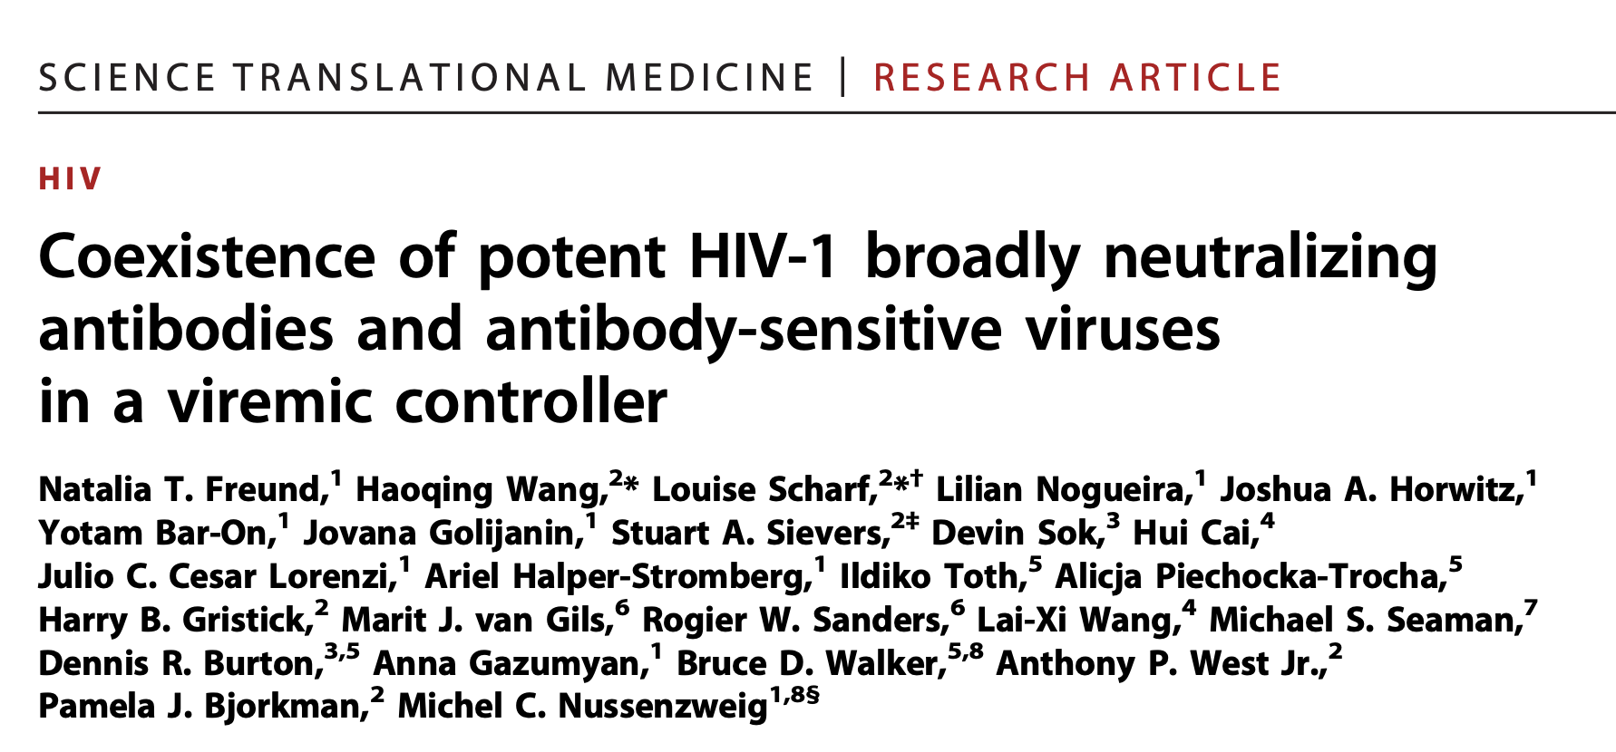
Presentation By:
Shea Mowry, Meghan Pinter, Maya Bartels, Felipe Munoz & Han Kahvecioglu
Notes:
https://www.ncbi.nlm.nih.gov/pmc/articles/PMC5467220/

Slide 2
Introduction

Slide 3
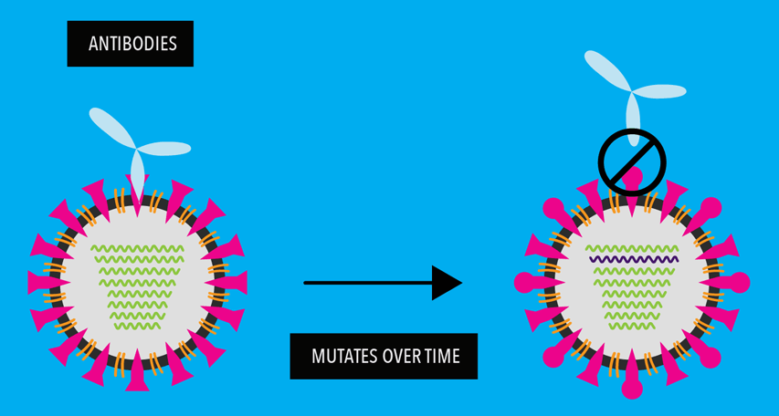
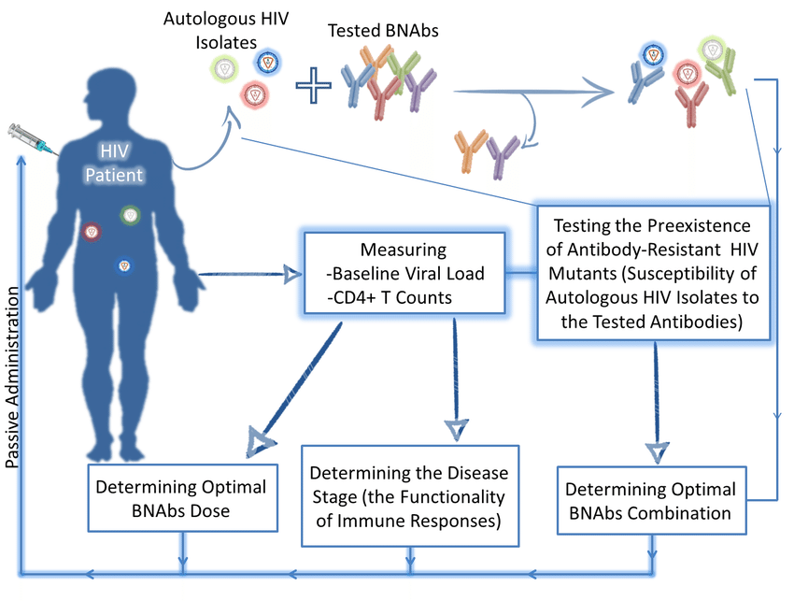
The Problem:
Introduction
broadly neutralizing antibodies (bNAbs)
HIV-virus and bNAb coevolution
Pfizer, 2024
Yaseen, M. M., Yaseen, M. M., & Alqudah, M. A. (2016). International Reviews of Immunology
→ bNAbs not be effective in controlling chronic HIV-1 infection for the individual who developed them
Notes:
A fraction of HIV-1–infected individuals develop broadly neutralizing antibodies (or bNAbs) that show potent neutralizing of a range of different HIV-1 isolates.
bNAbs typically develop over 1 to 3 years through iterative rounds of antibody gene mutation and selection to combat virus mutation.
When the first neutralization of virus occurs via early antibodies, the viruses start to feel pressure and will evolve to avoid death.
The antibodies are constantly evolving to respond and catch up with the continuously evolving circulating viral strains.
The viral strains that are sensitive to antibodies produced by the body will general be neutralized and die leaving a population of only host antibody-resistant HIV-1 variants. The body will continue to develop new antibodies to attempt to attack newly emerging strains but some of these non-sensitive strains can remain in circulation.
The end result of this coevolution is a population of bNAbs that can neutralize large numbers of heterologous viral variants but usually fail to neutralize autologous circulating viral strains. This means that bNabs may be unable to control HIV-1 chronic infection for the individual who developed them.
https://www.pfizer.com/news/articles/how_do_viruses_mutate_and_what_it_means_for_a_vaccine

Slide 4
Research Question:
Introduction
Is it possible to have “autologous bNAbs [that] can coexist with bNAb-sensitive viruses and contribute to HIV-1 control?”
Notes:
As with many immune system processes, however, there is large variation between individuals. Some individuals who develop highly neutralizing bNAbs can control their HIV-1 infection and maintain low viremia for many years. This led the researchers to investigate the research question: Is it possible to have autologous bNAbs [that] can coexist with bNAb-sensitive viruses and contribute to HIV-1 control?

Slide 5
Methodology

Slide 6
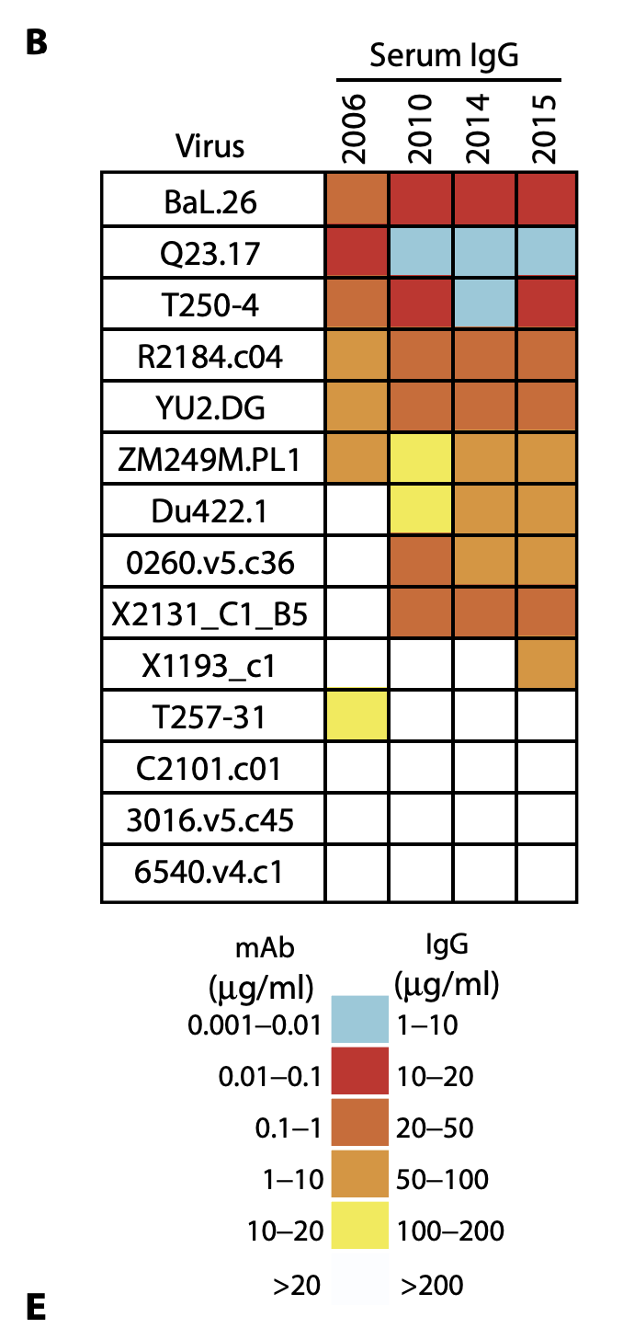
Donor Selection
Methodology
Long term control → unique immune response to HIV-1 without therapy
Broadly Neutralizing Antibodies → multiple bNAbs targeting different HIV-1 sites
Coexistence of sensitive viruses → presence of both potent bNAbs and sensitive HIV-1 strains
Notes:
One part of the paper’s methods that we thought was important to mention was the selection of the donor studied. This donor was chosen because they:
Long-term Control: maintained low viral loads for decades (30 years), indicating a unique immune response capable of controlling HIV-1 without antiretroviral therapy.
Broadly Neutralizing Antibodies (bNAbs): developed multiple bNAbs targeting different sites on the HIV-1 envelope, which are crucial for neutralizing a wide range of HIV-1 strains.
Coexistence of Sensitive Viruses: Despite the presence of potent bNAbs, the donor’s plasma contained HIV-1 strains that remained sensitive to these antibodies, providing a unique opportunity to study the interaction between bNAbs and the virus

Slide 7
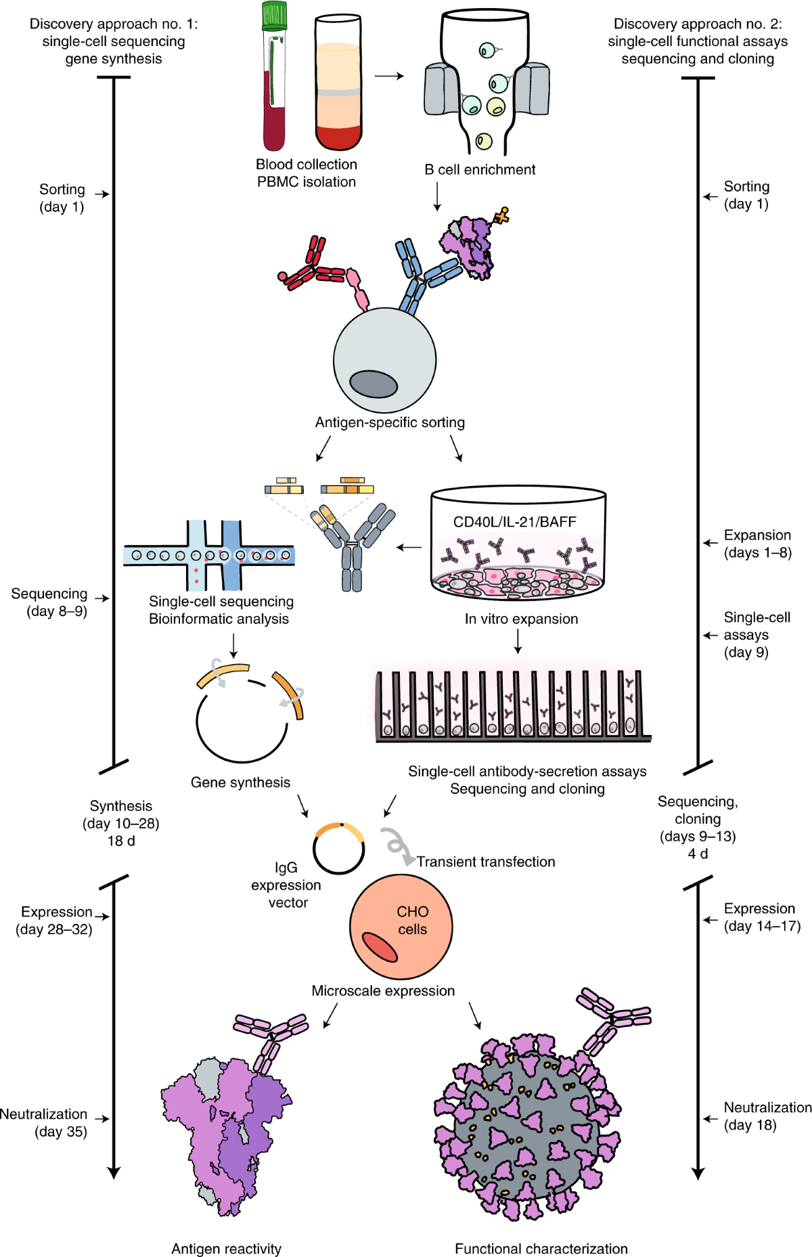
B Cell Sorting
Methodology
Human donor B cells sorted and pre-enriched with α-CD19 magnetic beads
B Cells stained with 4 different HIV-1 baits, covering all epitopes
Notes:
The magnetic beads are coated with anti-CD19 antibodies that specifically bind to CD19, a surface marker on B cells.
This allows the isolation and concentration of B cells from a mixed population of peripheral blood mononuclear cells (PBMCs) through magnetic separation.
This makes it easier to focus on the target cells for subsequent analysis and experiments.
Bait: an antigen, which mimics a part of the virus

Slide 8

Antibody Isolation
Methodology
Igλ & Igκ chains amplified using primers
PCR products cloned into vector
Antibodies produced using human embryonic kidney cells
Notes:
Igλ & Igκ chains amplified using rescue and regular primers respectively.
PCR products were sequenced and analyzed. Then the purified and digested PCR products were cloned into human Igg1, Igk, or Igλ expression vectors .
The PCR products with the expression plasmids produced using human embryonic kidney cells.

Slide 9
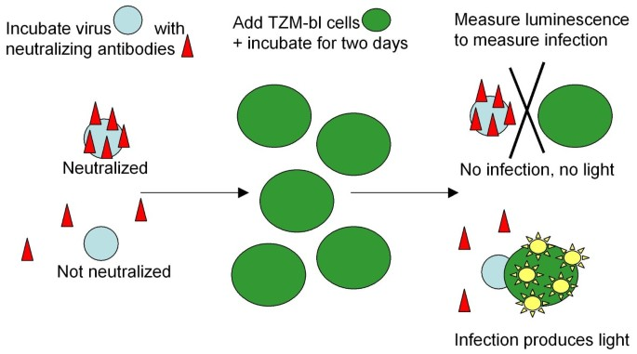
HIV-1 Neutralization
Methodology
Virus is neutralized using luciferase-based TZM-bl cell assay
Env pseudoviruses were incubated with fivefold serial dilutions of single antibodies
Applied to TZM-bl cells
Recorded luminescence reduction of 50% and 80%
Notes:
The luciferase-based TZM-bL cell assay measures the neutralization of HIV-1 by antibodies. It works by measuring how much the expression of the firefly luciferase reporter gene is reduced after a single round of infection with Env-pseudotyped viruses.
Env pseudoviruses were incubated with fivefold serial dilutions of single antibodies
Env-pseudotyped viruses are a type of virus that are used in research to study HIV-1 neutralizing antibodies and other viruses. They are produced by co-transfecting cell lines with an Env expression vector.
Applied TZM-bl cells because they are permissive to infection by many strains of HIV

Slide 10
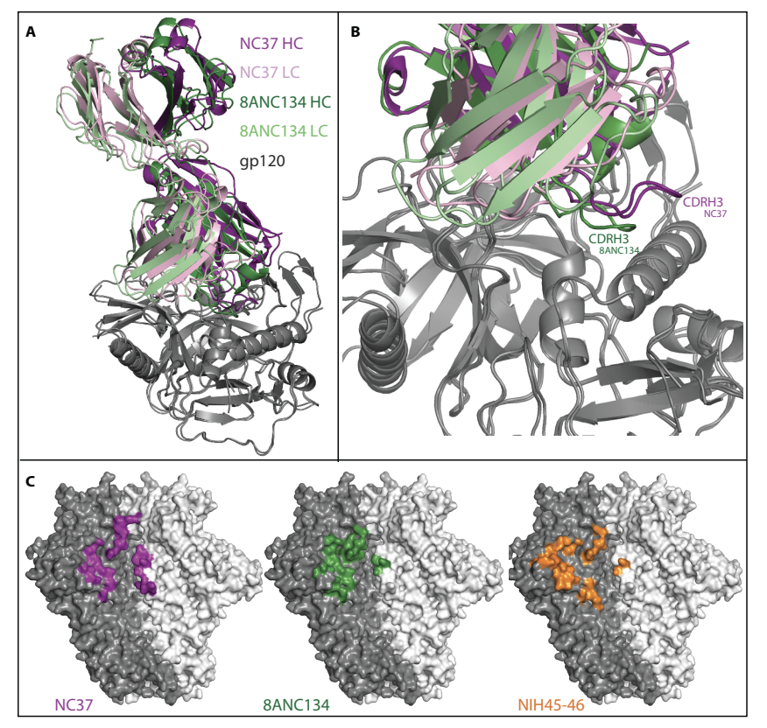
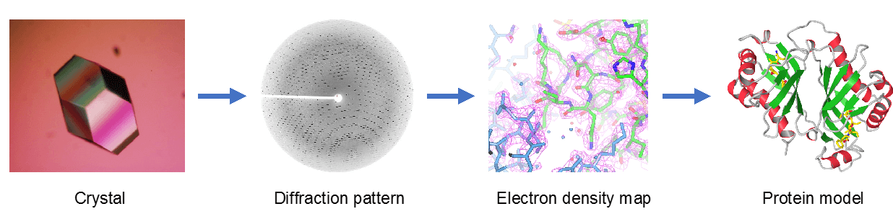
X-ray Crystallography
Methodology
Explored structure of Fab fragments & gp120 protein complex
Figure S3: NC37 Fab-gp120 complex structure.
Notes:
We will talk more about this in a few slides, X-ray crystallography helps you visualize protein structures.
In this paper they explored the structure of Fab fragments and the GP120 protein complex.
Fab fragments are regions of an antibody that binds to antigens
Gp120 is a glycoprotein on the surface of HIV cells that helps the virus enter host cells
https://www.science.org/doi/suppl/10.1126/scitranslmed.aal2144/suppl_file/aal2144_tables_s1_to_s5.zip

Slide 11
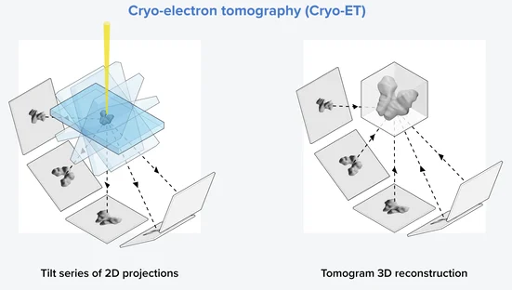
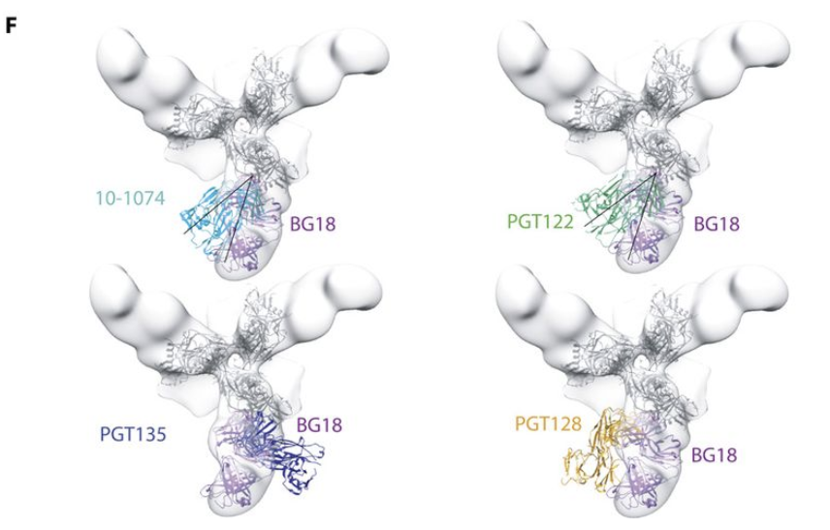
Cryo-Electron Tomography/Subtomogram
Methodology
Provides high resolution structure using single-particle EM
BG18 bNAb
Fig. 2. Sequence and structural analysis of BG18 bNAb
Notes:
Again, we will talk more in depth about Cryo-Electron Tomography/Subtomogram. This method provides high resolution structure images using single particle electron microscopy.
This paper uses it to look at the BG18 bNAb.

Slide 12
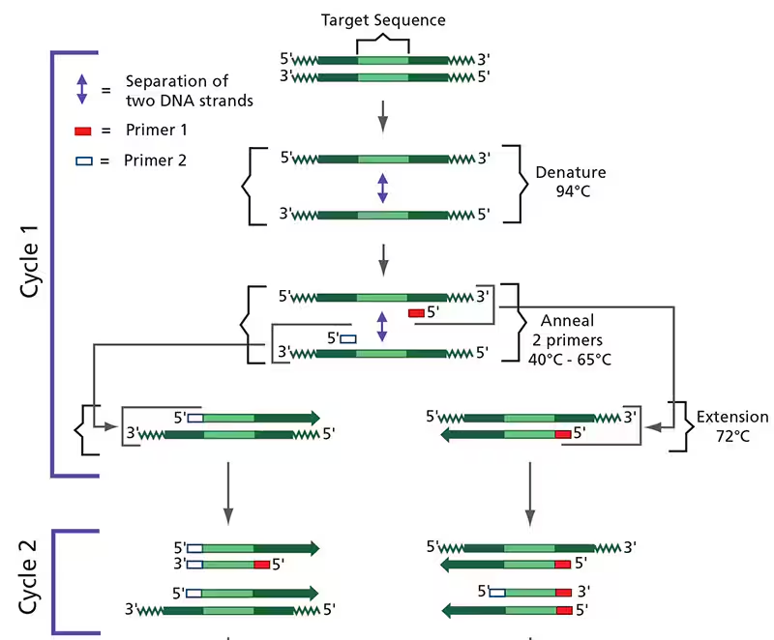
Autologous Virus
Methodology
HIV-1 RNA extracted from donor plasma.
2 rounds of PCR performed to amplify the HIV-1 RNA extracted from the donor.
CMV-Env expression cassettes were generated and then transfected into 293T cells.
Notes:
Maya

Slide 13
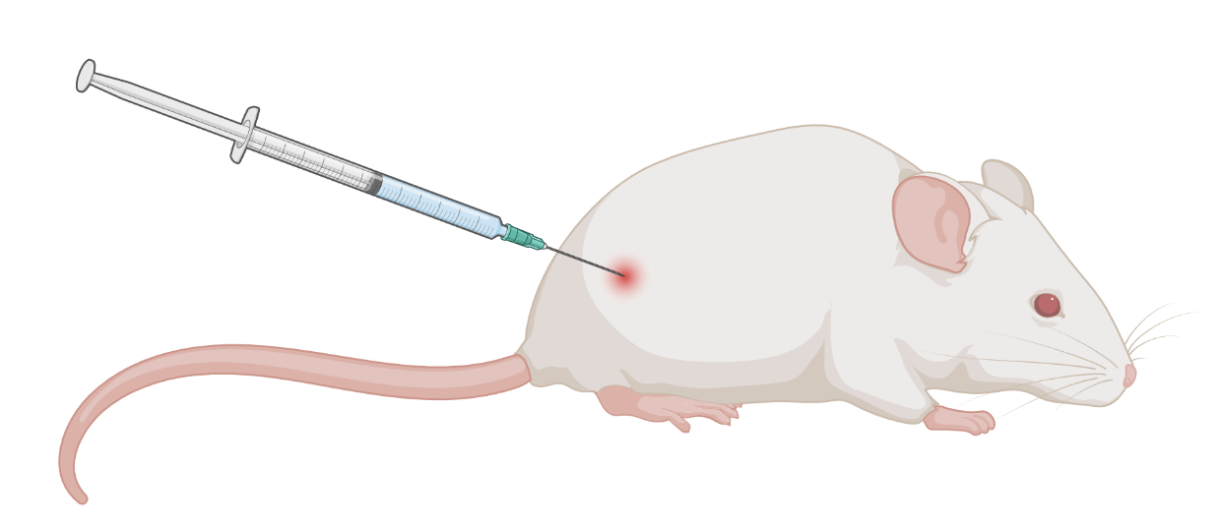
In vivo Mouse Model
Methodology
Using humanized nonobese diabetic mice - IACUC approved protocols
Mice treated subcutaneously with 1 mg dose of each antibody twice per week for 3 weeks (6 total antibody injections).
Control humanized mice: reconstituted with donor cells and infected with HIV but not treated with antibodies
Measurement: Plasma viral loads (weekly)
Notes:
Maya

Slide 14
Results

Slide 15
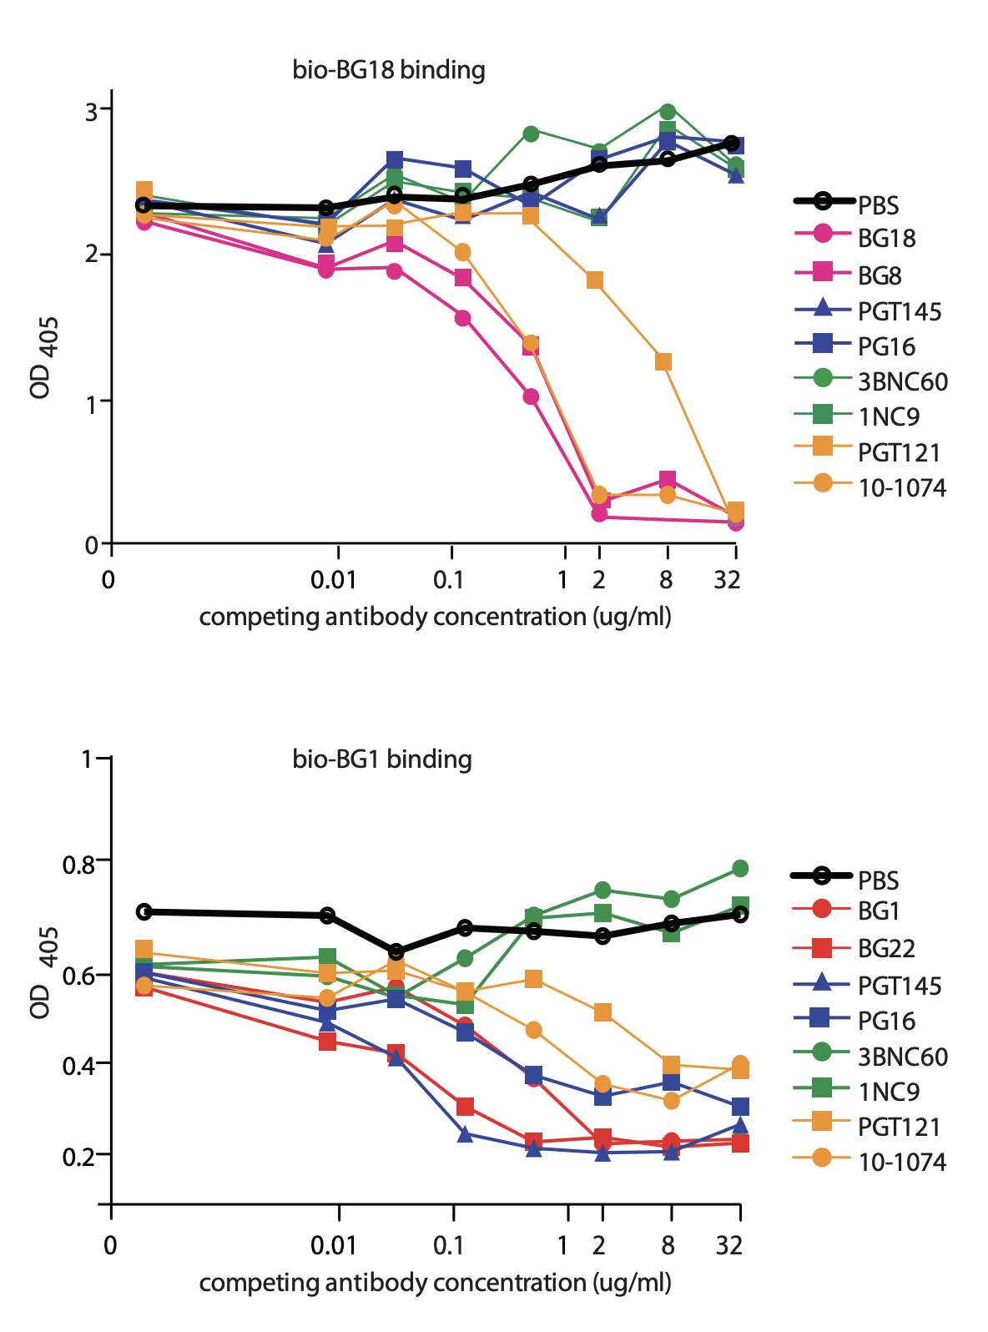
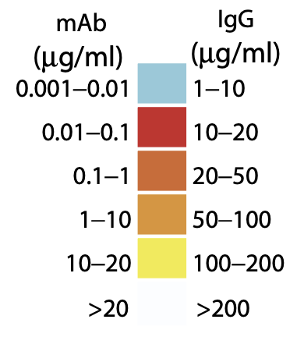
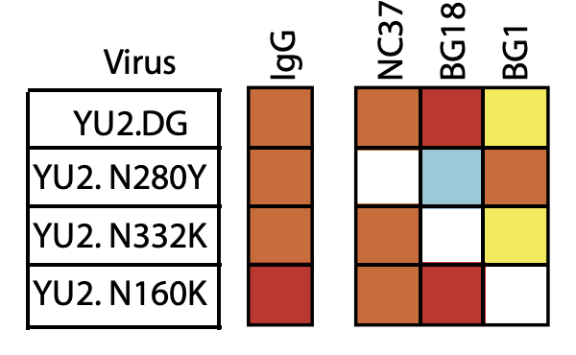
Measuring bNAb affinity
Results
Introduce epitope-specific point mutations into HIV-1 YU2 (well-characterized clade B strain)
IgG - polyclonal antibodies (positive control)
N280Y - CD4 binding site
N332K - glycan-V3
N160K - V1V2
Competitive ELISA (enzyme-linked immunosorbent assay) for validation
Notes:
Felipe

Slide 16
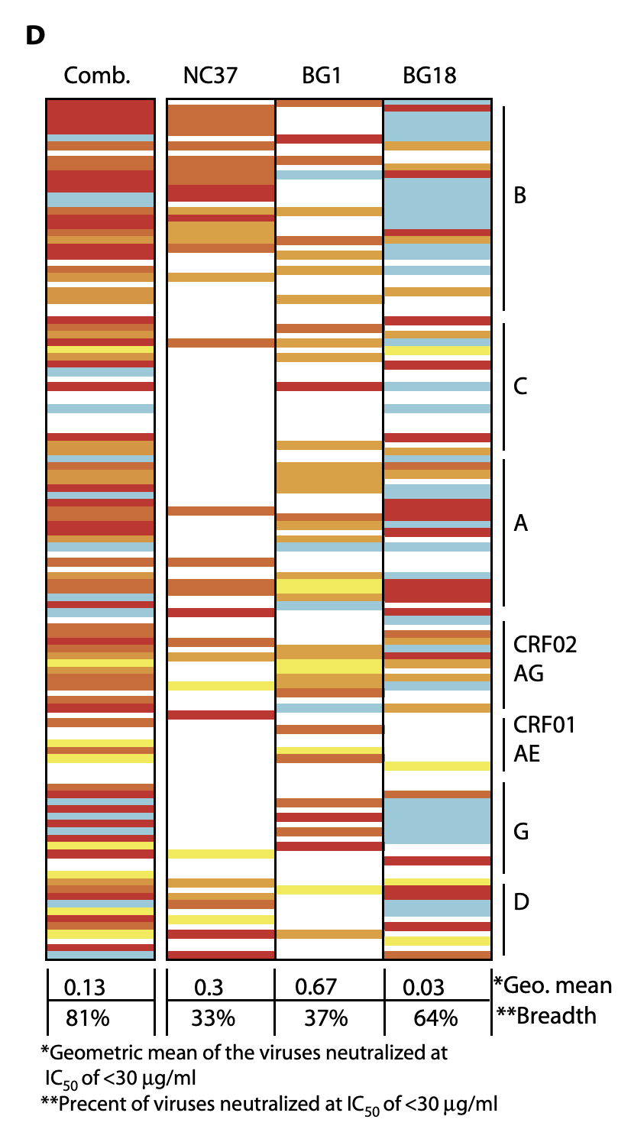
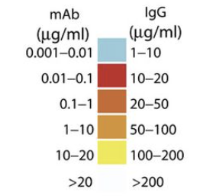
Measuring bNAb affinity
Results
Neutralization potency of NC37, BG1, and BG18 tested against HIV-1 pseudovirus.
BG18 neutralized more than NC37 and BG1 when not mixed, but a combination produced 81% neutralization of HIV-1.
BG18 emerged between 2010 and 2013, NC37 and BG1 emerged earlier.
Notes:
Maya
BG18 is the most potent bNAb (as seen in the figure)

Slide 17
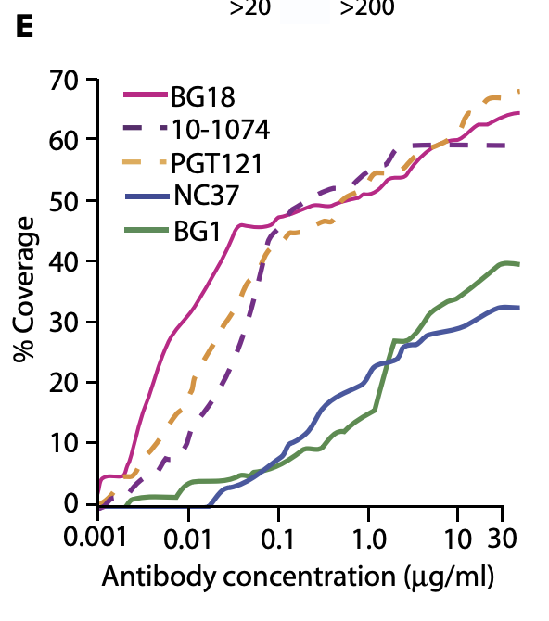
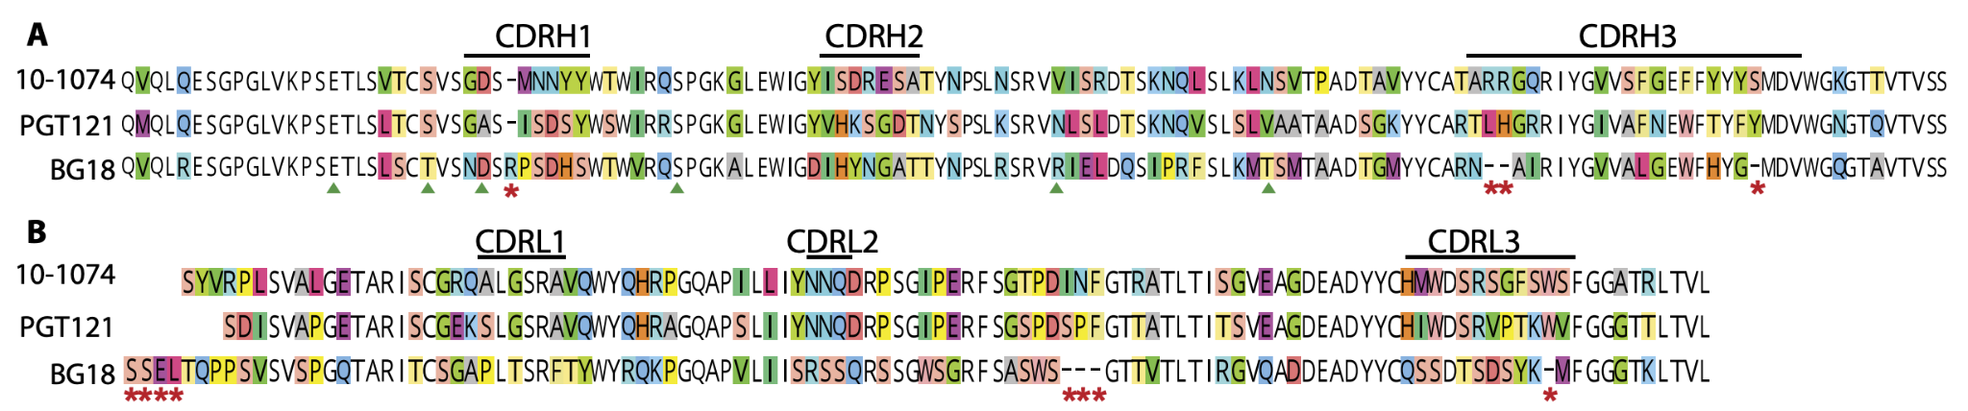
BG18
Results
Emerged between 2010 and 2013
Comparable to PGT121 and 10-1074 - previously discovered bNAbs targeting V3
BG18 more potent
Heavy Chain
90% identity of germline genes
Less than 62% identity of mature heavy chain
Light Chain
70% germline
48% mature
Notes:
Felipe

Slide 18
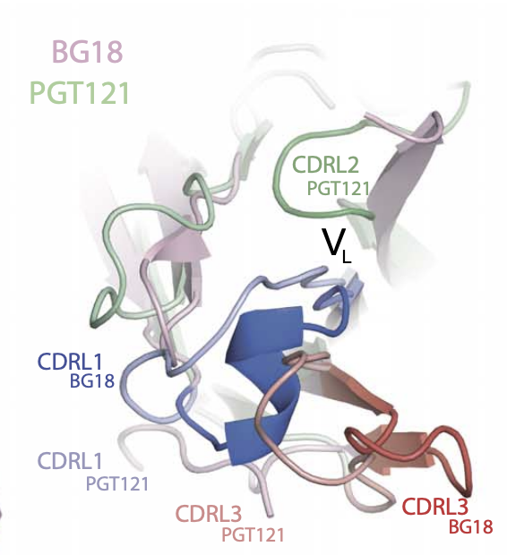
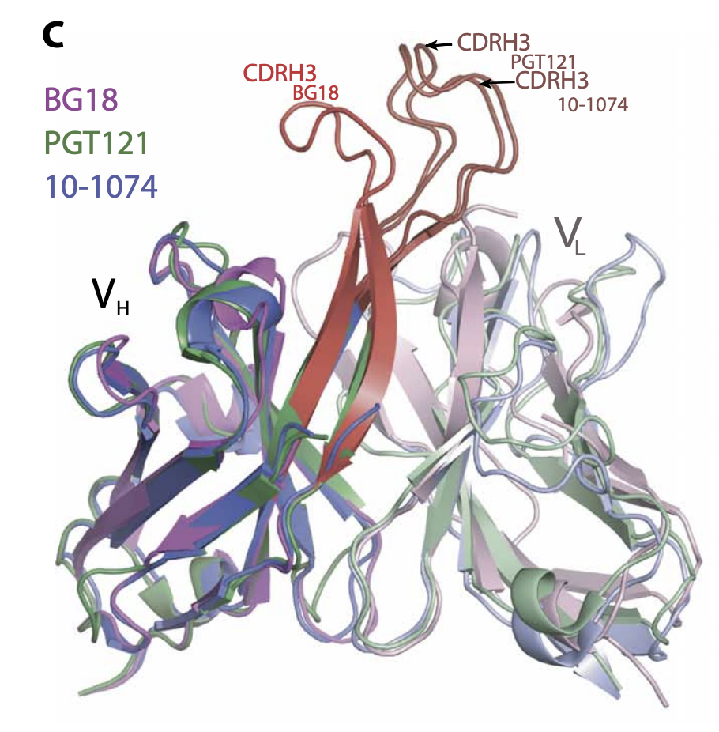
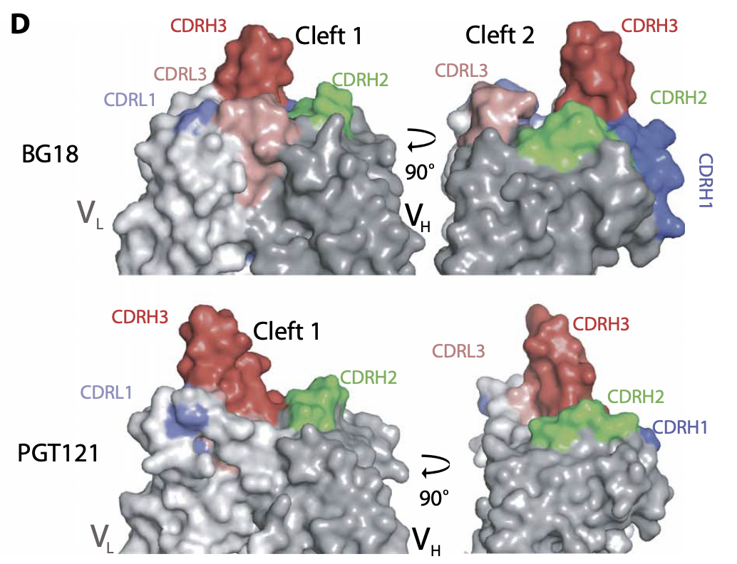
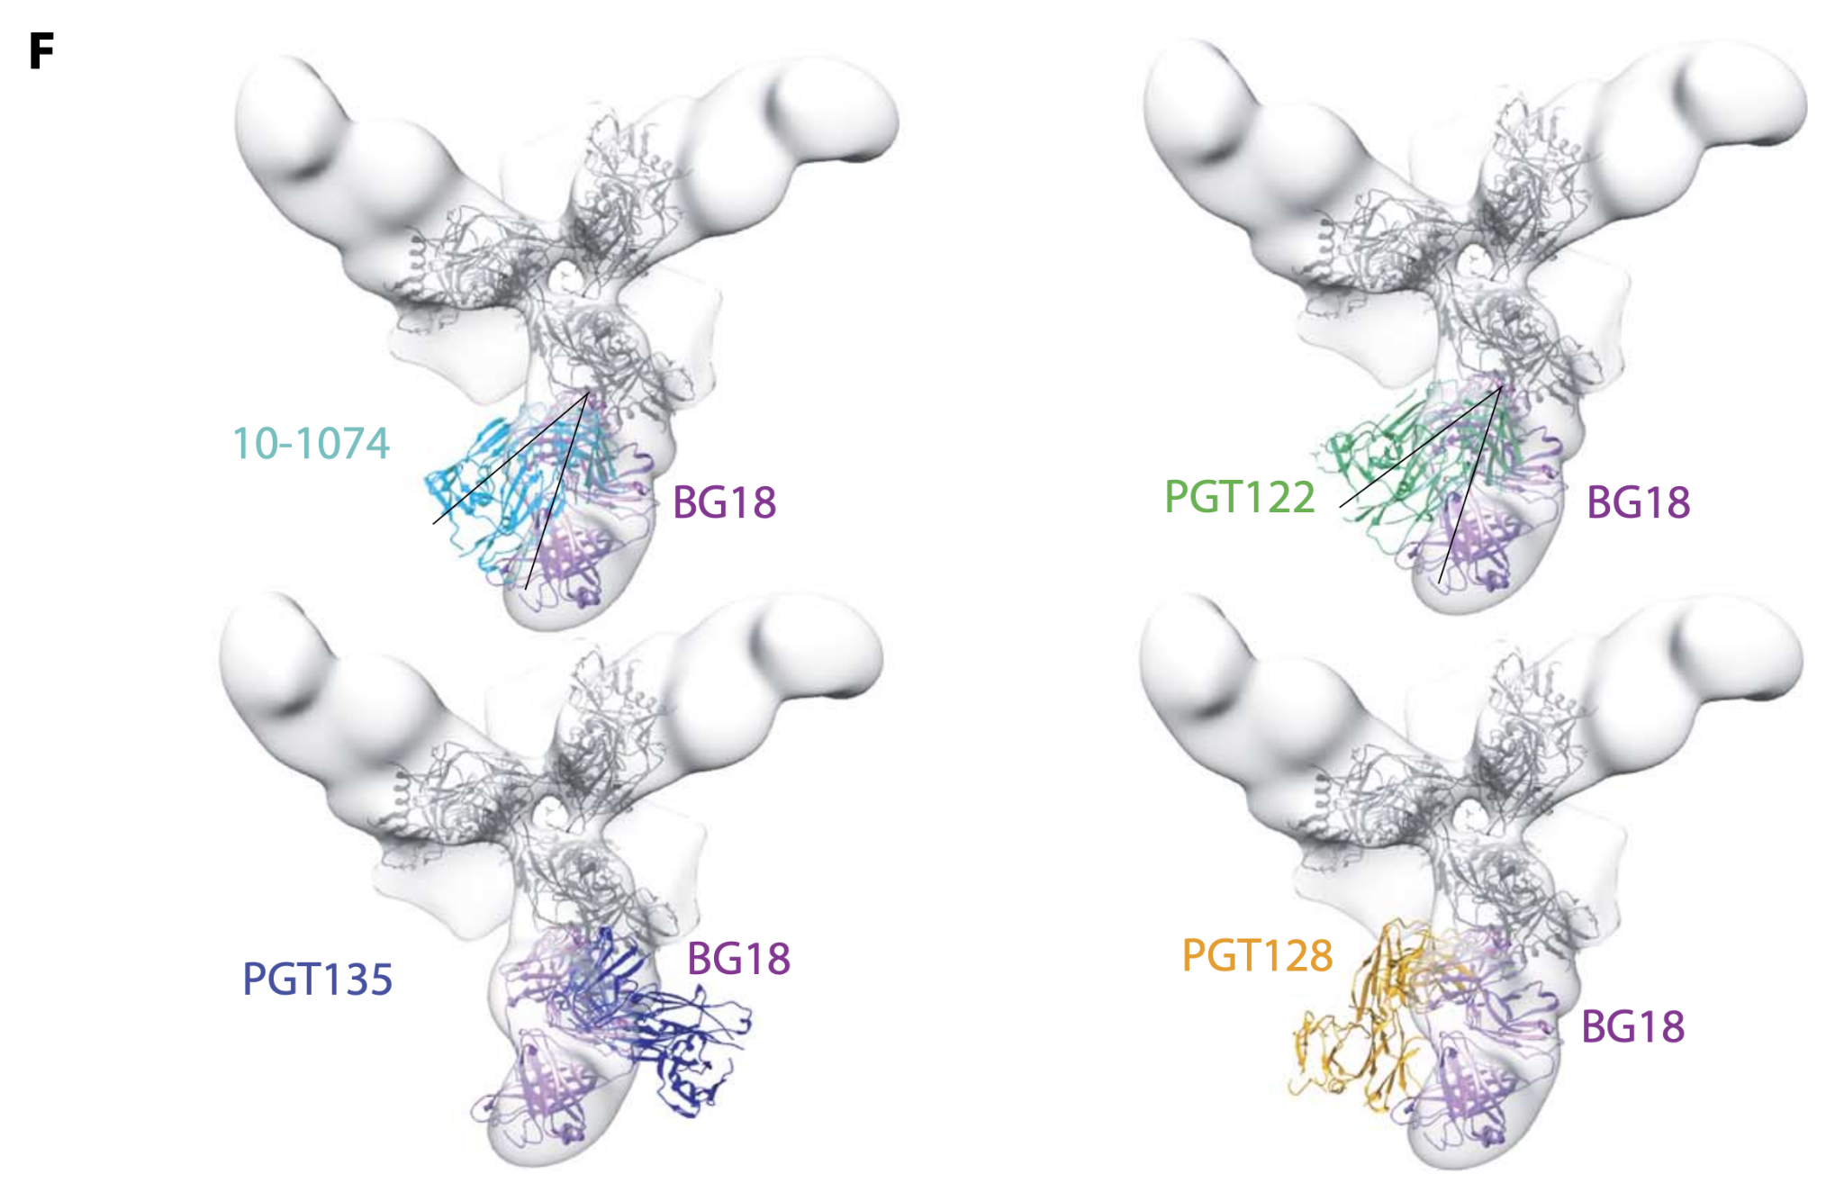
BG18 Fab (Fragment antigen-binding) structure
Results
CDRs - complementarity determining-regions
Part of variable region of antibody
3 CDRs on heavy and light chains
CDR3 most diverse
Notes:
Felipe

Slide 19
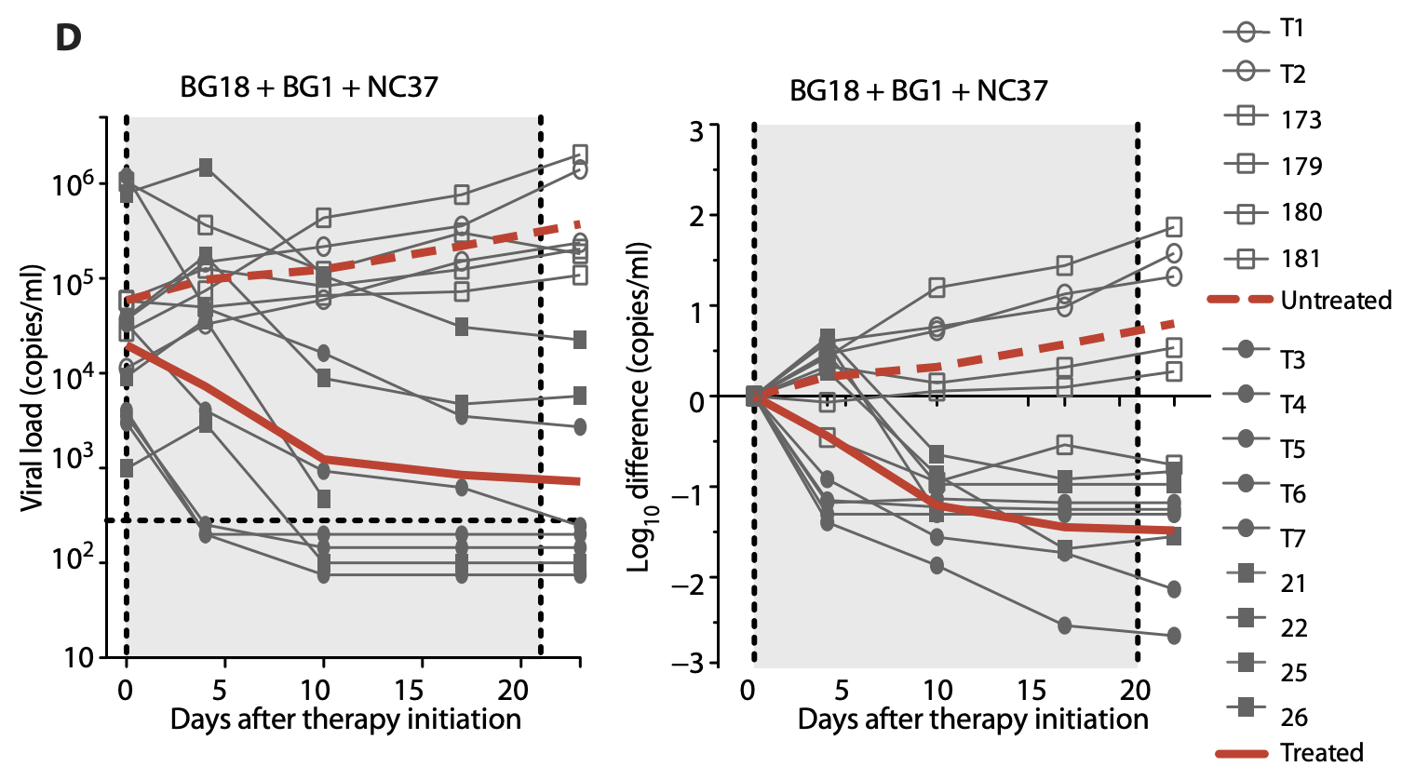
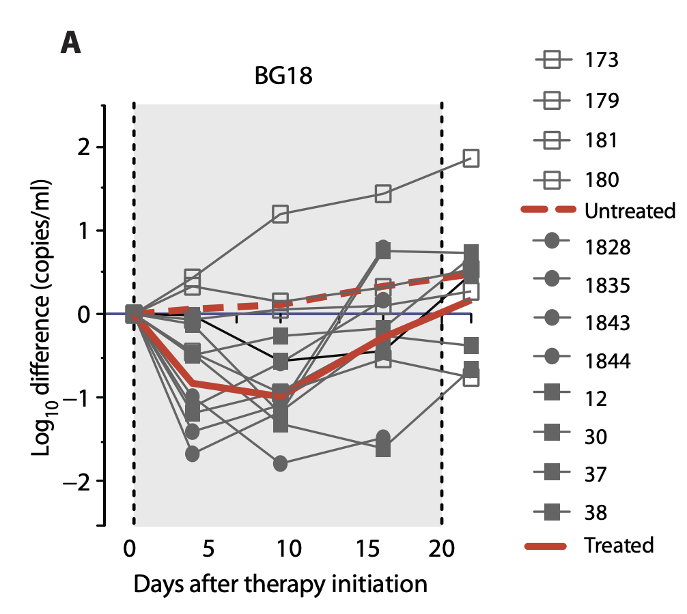
Combination-bNAb Therapy Controls HIV-1 in Mice
Results
Nine HIV-1YU2-infected humanized mice treated with 1:1:1 combination of new bNAbs
Effect: prolonged drop in viremia
6 of 9 mice showed undetectable viral load after 3 weeks
Notes:
Felipe

Slide 20
Results - Outline
Isolated three new bNAbs that account for serologic neutralizing activity and circulating viruses
BG18 (the most potent)
Structural findings
targets Asn332 gp120-centered glycan patch (frequent target for anti–HIV-1 bNAbs, because contains key carbohydrates bNAbs bind to)
BG18 approaches HIV-1 envelope protein from a different angle (vs. other well known antibodies)
BG18 Fab has distinct orientation and a shorter length of CDRH3 region (compared to other members of the same class)
Lack of insertions or deletions in the BG18 CDRH3 suggests that BG18-like antibodies may be easier to elicit by vaccination.
Notes:
The three bNAbs are significant because they can neutralize a wide range of HIV strains.

Slide 21
Results - Outline
The other two neutralizing specificities:
BG1
binds to V1V2 region of Env (frequent target of bNAbs arising in natural infection)
first antibody in this class to be isolated from a clade B–infected donor
is potent, but not as strong as other known bNAbs
NC37
uniquely, NC37 recognizes a quaternary trimer epitope, the core of which overlaps with the CD4bs (important region for viral entry into cells)
Key outcomes
EB354 developed multiple bNAbs recognizing different parts of the HIV-1 Env protein. Non overlapping targets provides broader protection
Mouse trials confirmed BG1, BG18, and NC37 combined were able to suppress HIV-1 infection, indicating potential therapeutic use: combination antibody therapy
Notes:
The three bNAbs are significant because they can neutralize a wide range of HIV strains.
BG1, BG18, and NC37 were combined and tested in mice they were able to suppress HIV-1 infection, indicating potential therapeutic use.

Slide 22
Highlighting Structural Analysis Techniques

Slide 23
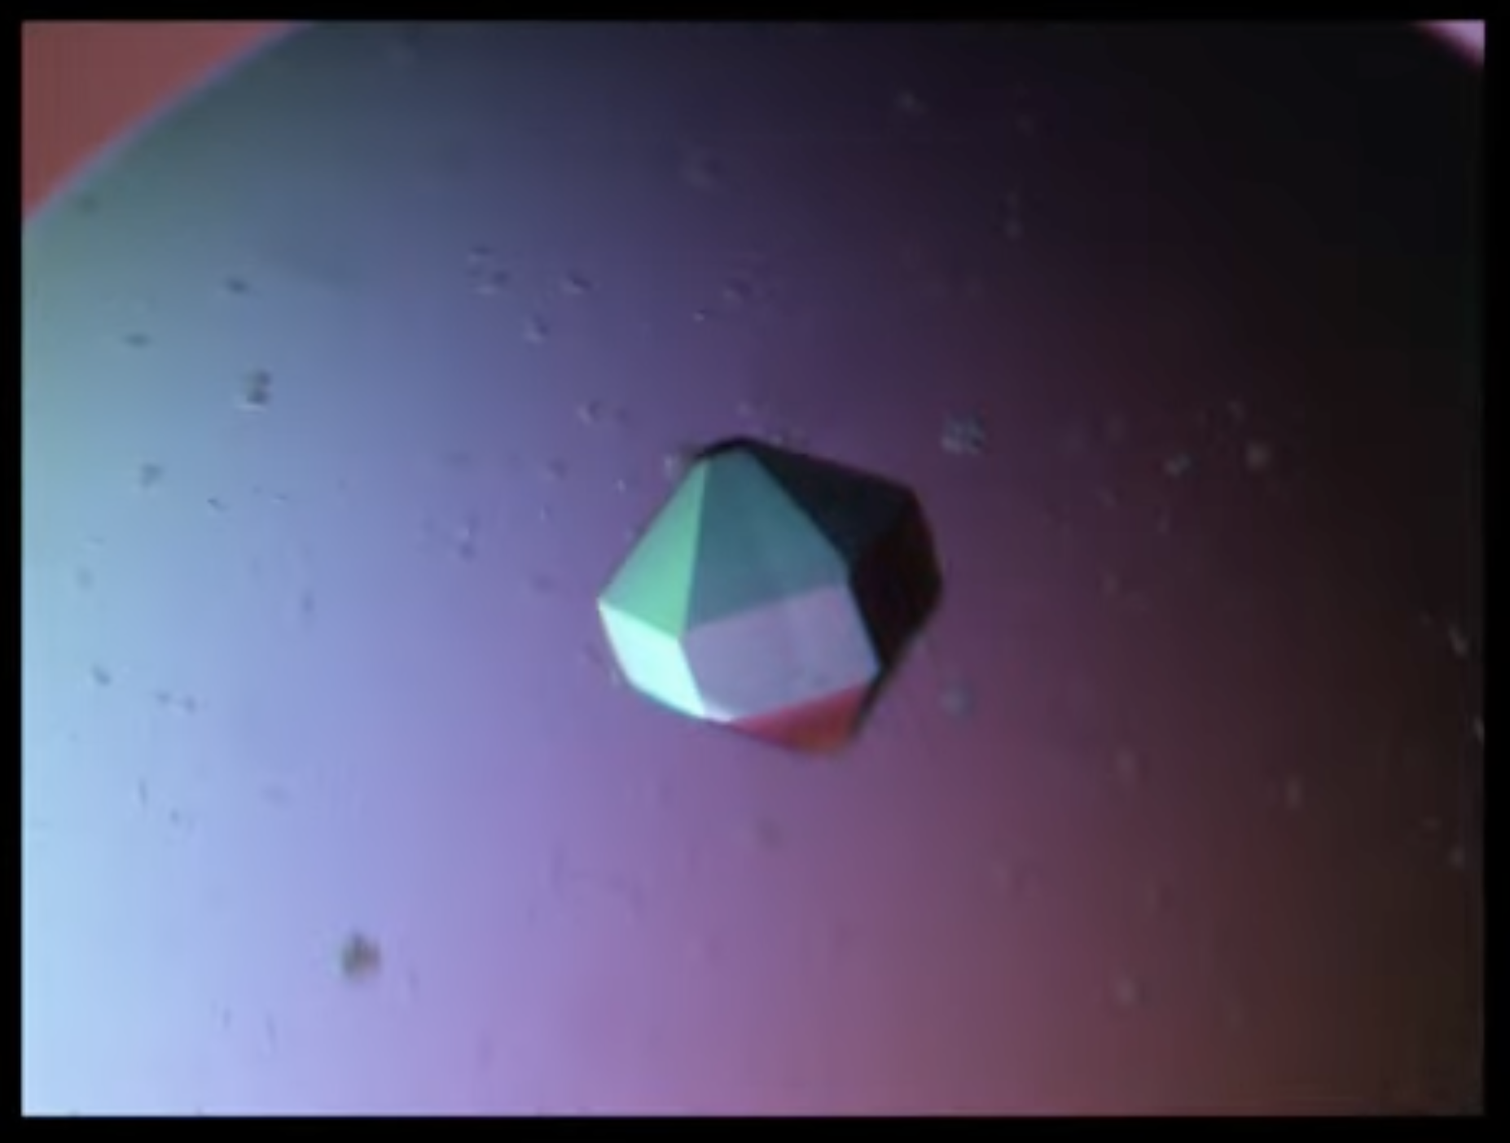
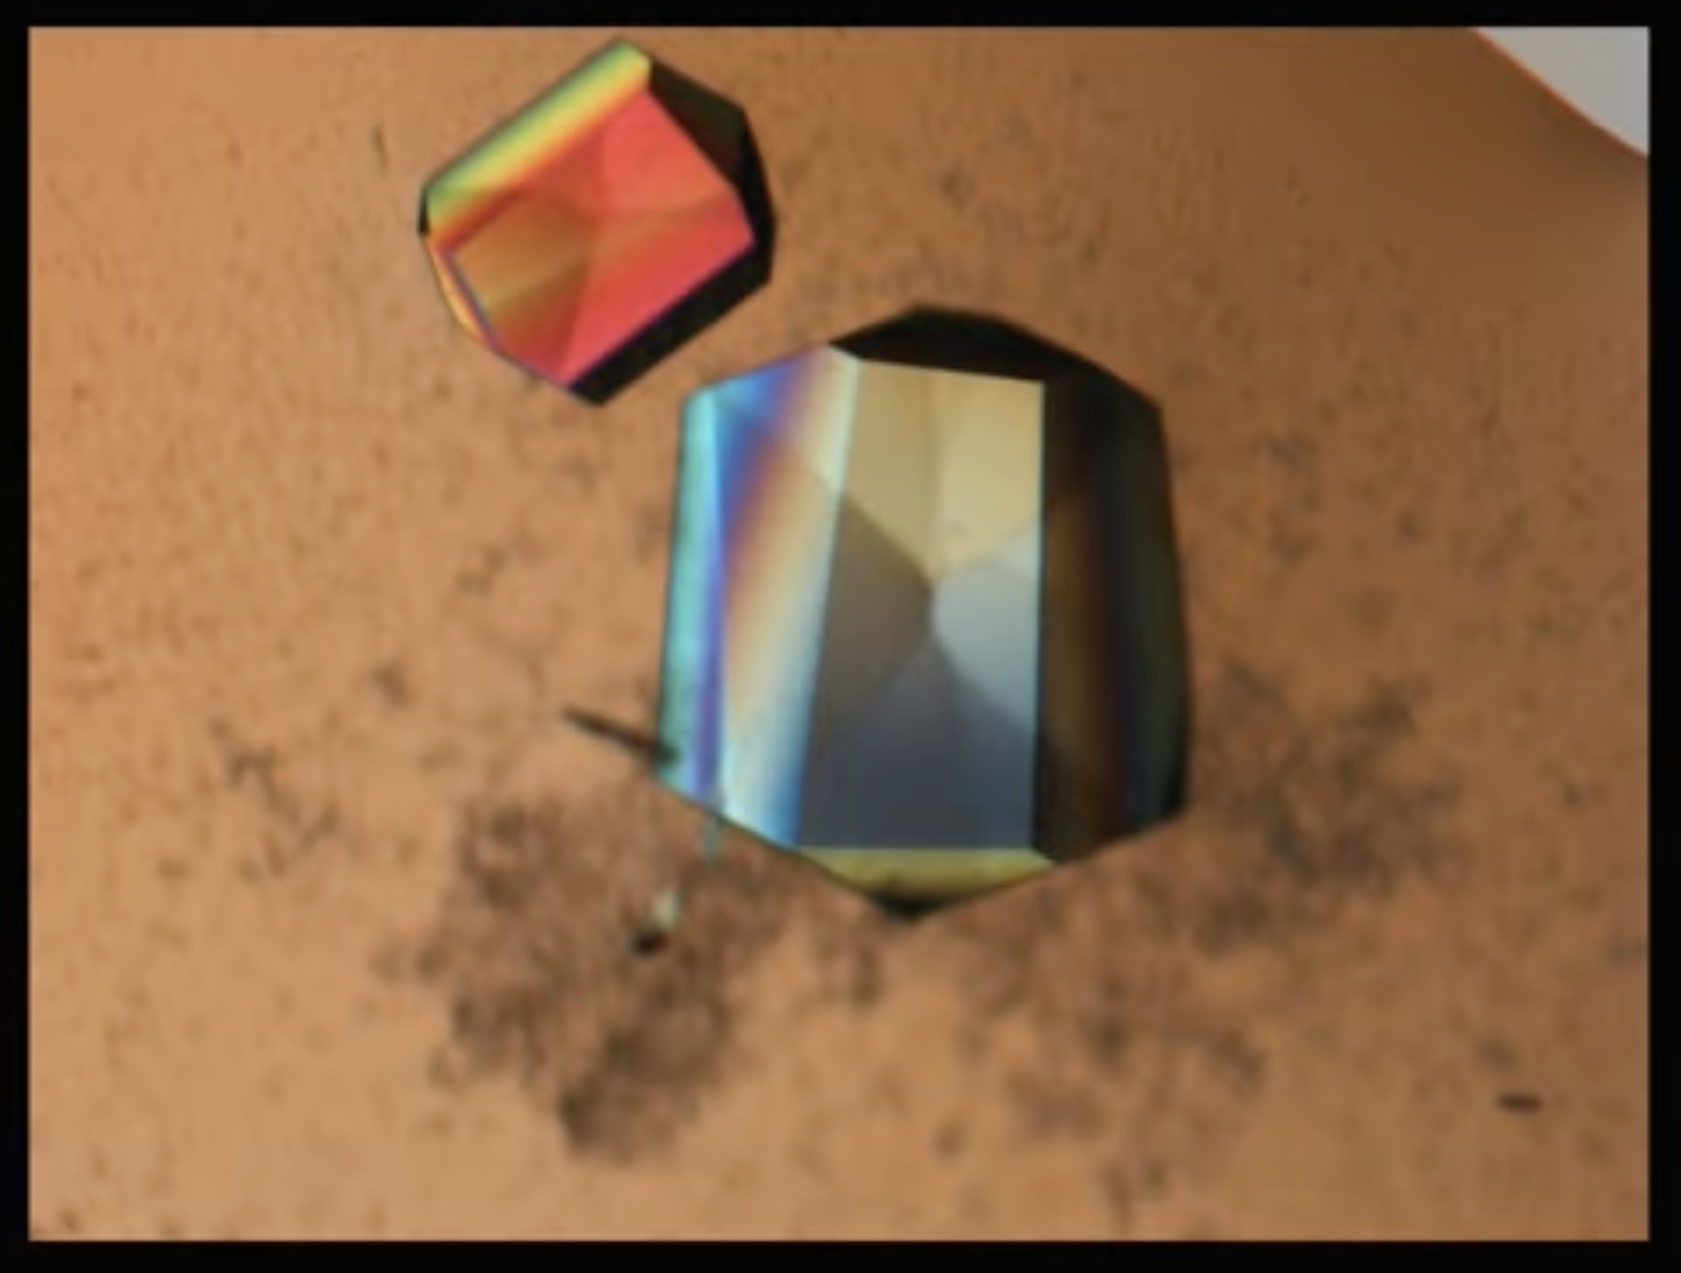
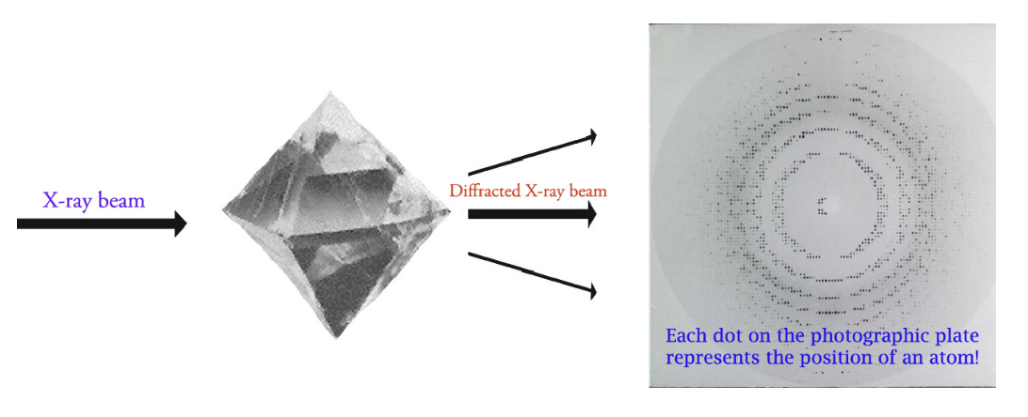
X-Ray Crystallography
Target is crystallized
Target is irradiated with x-ray beams
Target shape reconstruction
Purified and crystallized
Highly-ordered, solid state
X-rays interact with electrons in molecule
Produce diffraction pattern
Reveals density map at angstrom resolution
Target structure deduced from diffraction data
Use computational techniques like molecular replacement (MR)
Iowa State University Chemical Instrumentation Facility
From Royal Institute: “Understanding Crystallography”

Slide 24
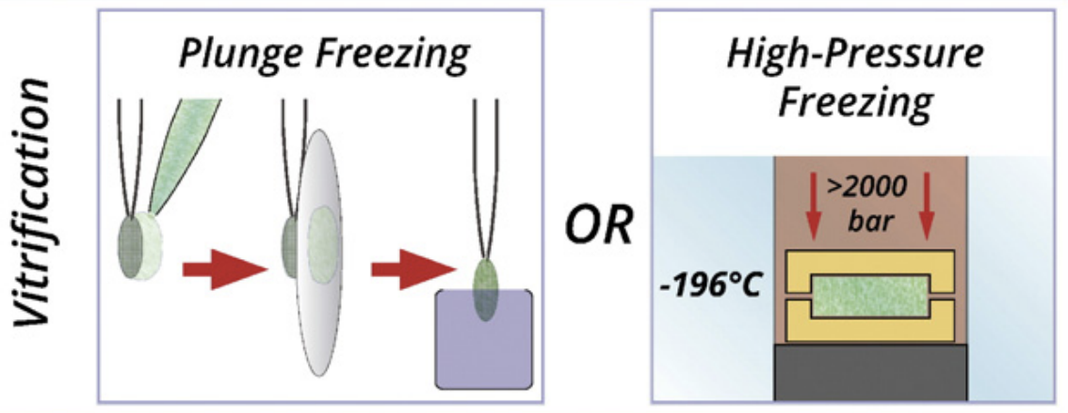
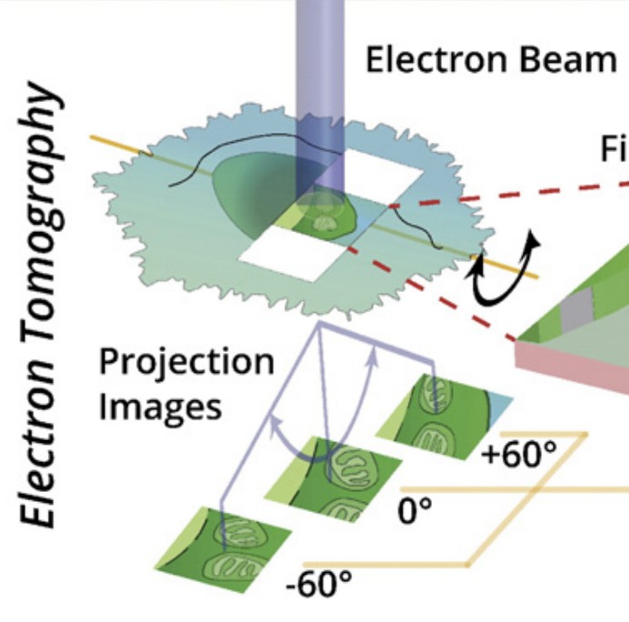
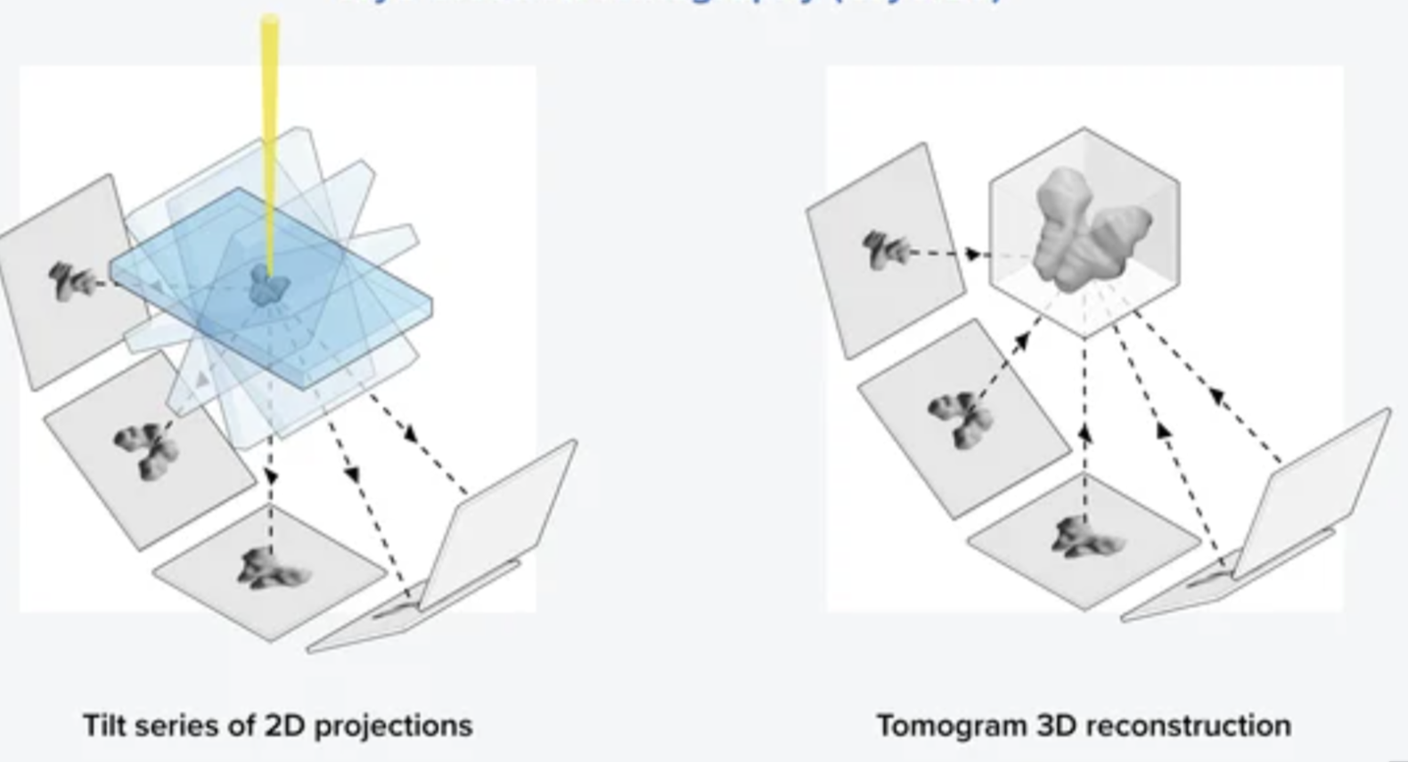
Cryo-electron tomography
Sample is
flash frozen
Sample is placed under electron microscope
Sample is rotated and imaged
Frozen, then sectioned
This keeps tissue close to its native state
High pressure freezing avoids formation of ice
Use of EM means no staining is needed
Allows nanometer resolution
Not a traditional electron microscope, specialized equipment to tilt the sample
2D images used to understand 3D structure, just like a tomography scan
Images collected from many angles, computationally merged to obtain 3D structure
(Asano, et al.)
(Asano, et al.)
(Asano, et al.)
(“What Is the Difference between Cryo-EM and Cryo-Et?”)
Notes:
Han

Slide 25
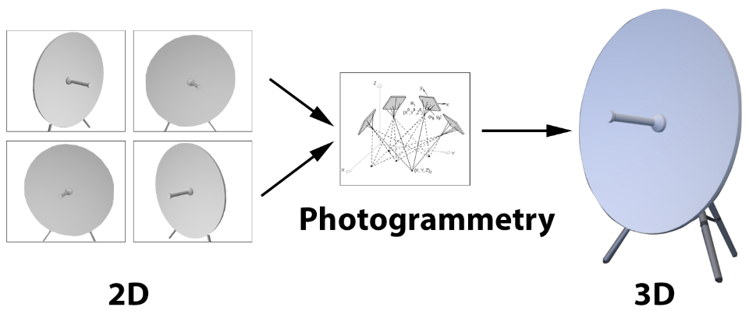
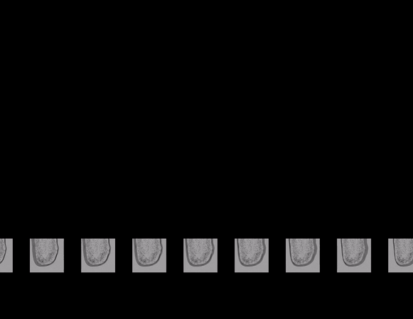
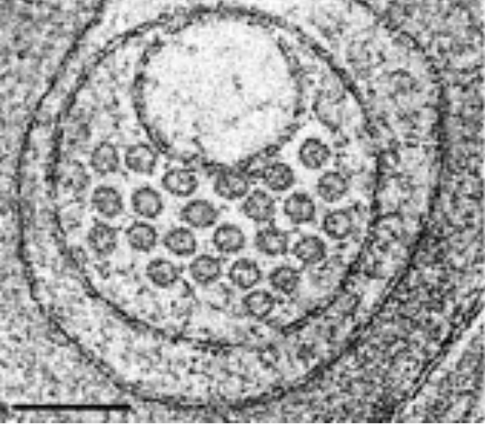
Cryo-electron tomography
(“Basics of Photogrammetry”)
If you have images of an object from multiple angles, and figure out the points in space you are looking at the object from, you can figure out the 3D shape of the given object.
Cryo-ET does this on a nanometer-scale, using electron beams, meaning instead of an images we have tomograms
(David H., et al.)
(“Cryo EM Tomography.”)
Notes:
Han

Slide 26
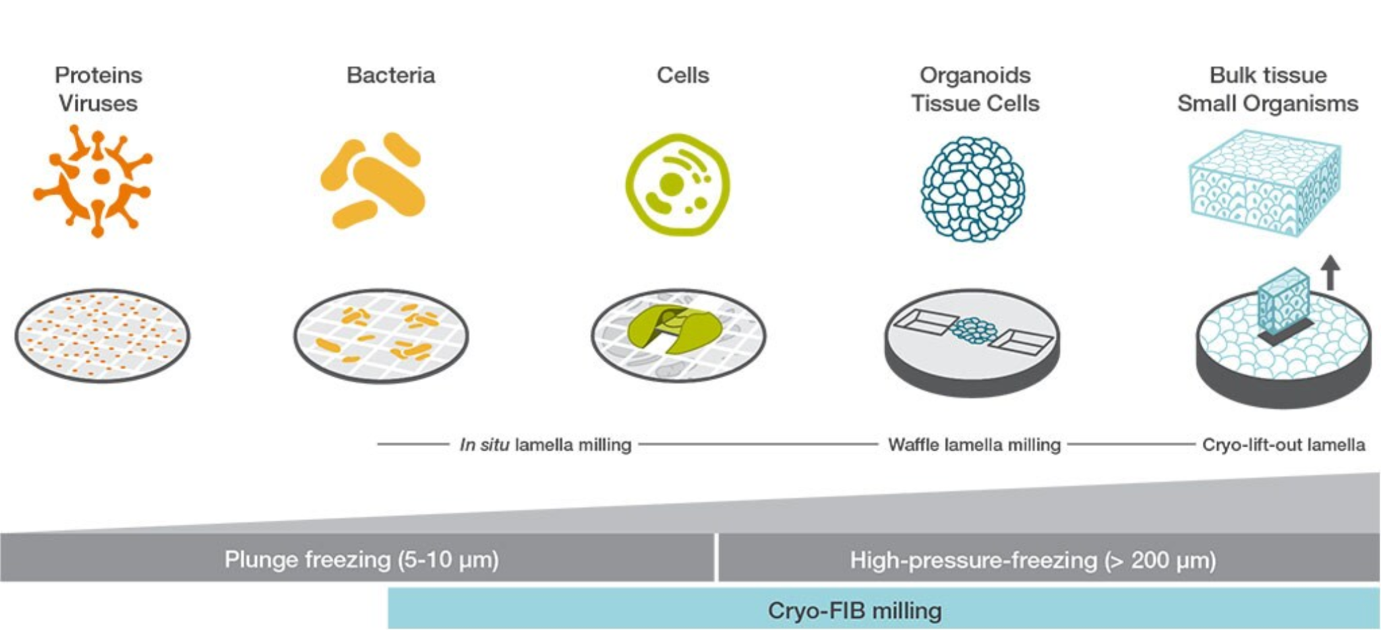
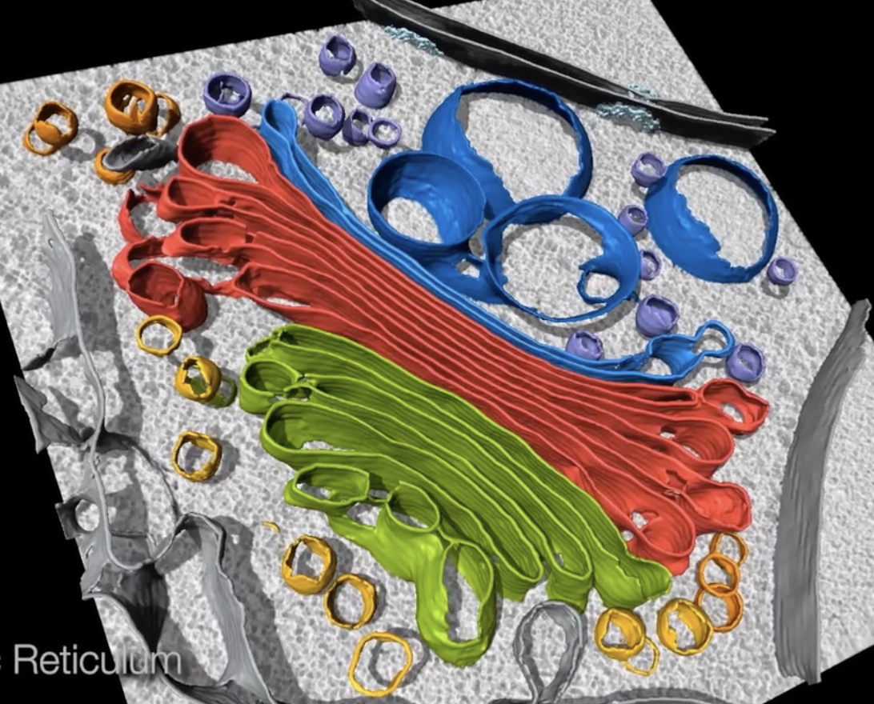
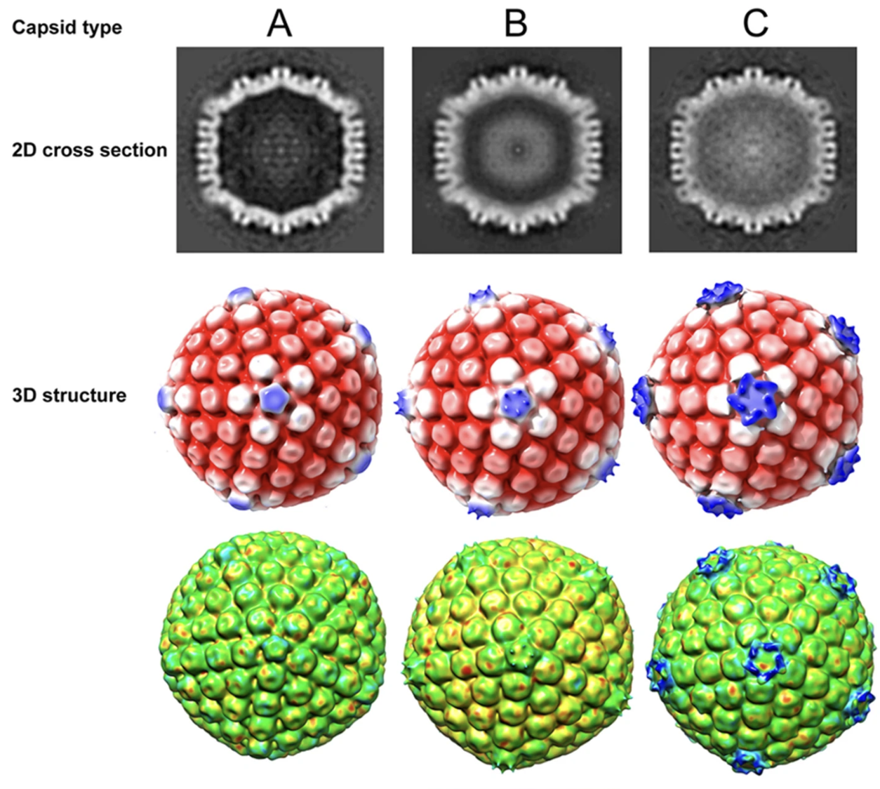
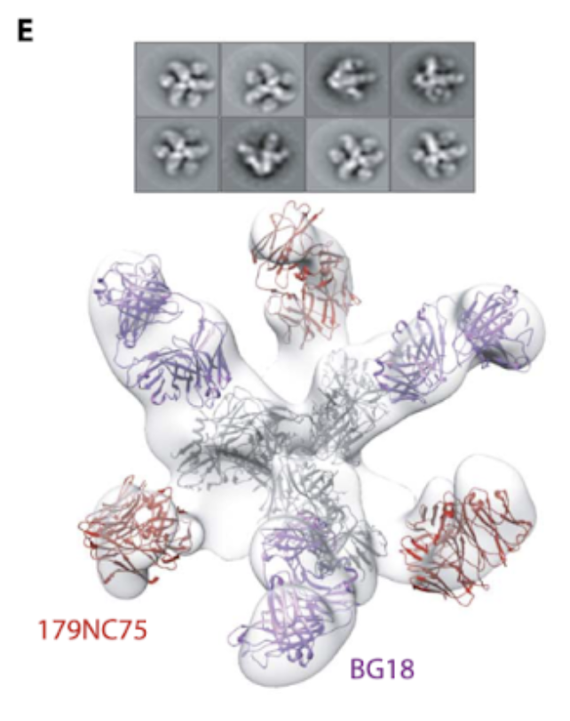
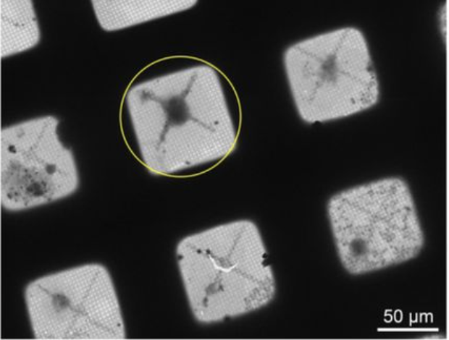
Cryo-electron tomography
Many types of samples can be investigated. Tissue preparation changes slightly based on sample; for smaller samples like proteins, placed on an “electron microscopy grid”.
(“Cryo-Electron Tomography Technology.”)
Subcellular structures
Viruses
Proteins
(“Cryo-Electron Tomography Sample Data.”)
(Vijayakrishnan, Swetha, et al.)
(Freund, Natalia T., et al.)
(Sibert, et al.)
Notes:
Han

Slide 27
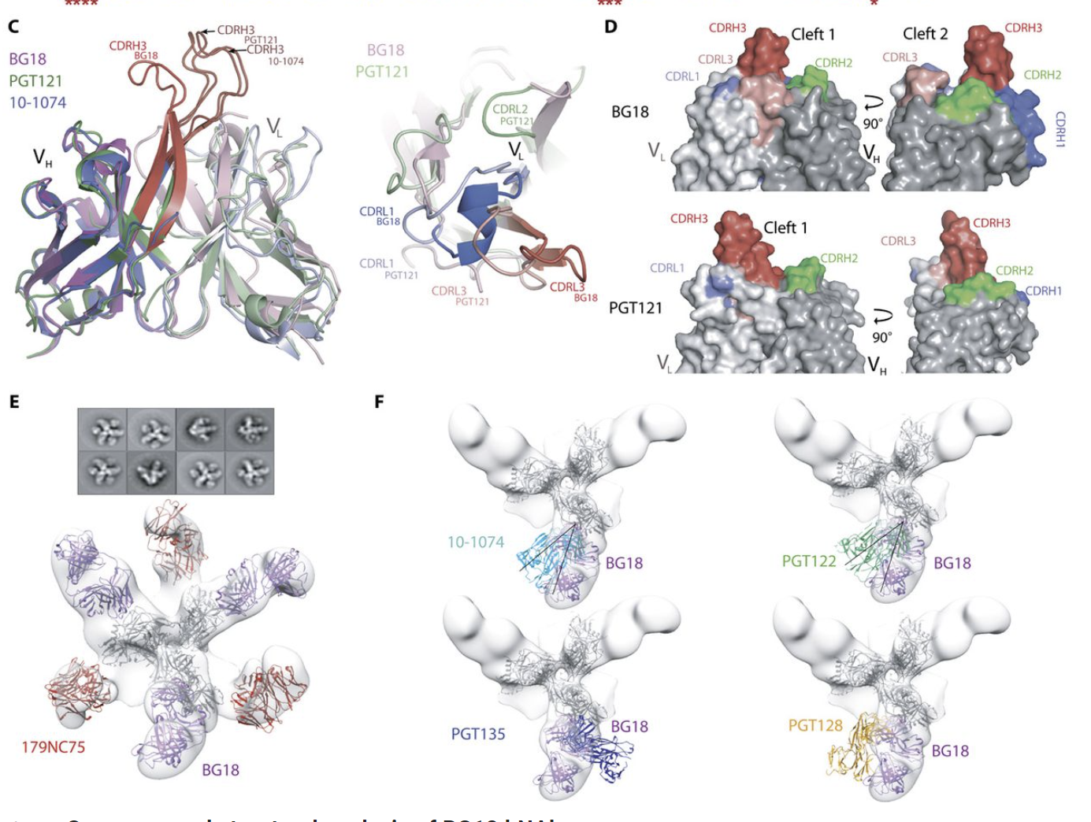
Cryoelectron tomography/subtomogram: Analysis Tools
RELION - Unsupervised 3D Classification
Determine the structure of BG18, PGT121, 10-1074 using cryo-EM data
Uses Bayesian approach → infers parameters for statistical modeling of data. Parameters are usually something that researchers need to know how to tune.
Yields reconstruction of biological molecules
UCSF Chimera
Program used to visualize and interact with molecular models
Used to generate structural images of BG18, PGT121, 10-1074
Notes:
Maya

Slide 28
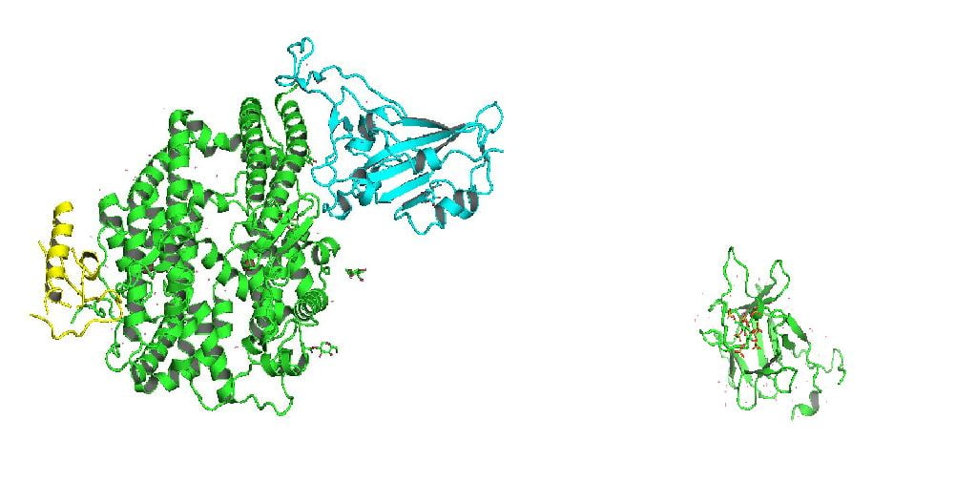
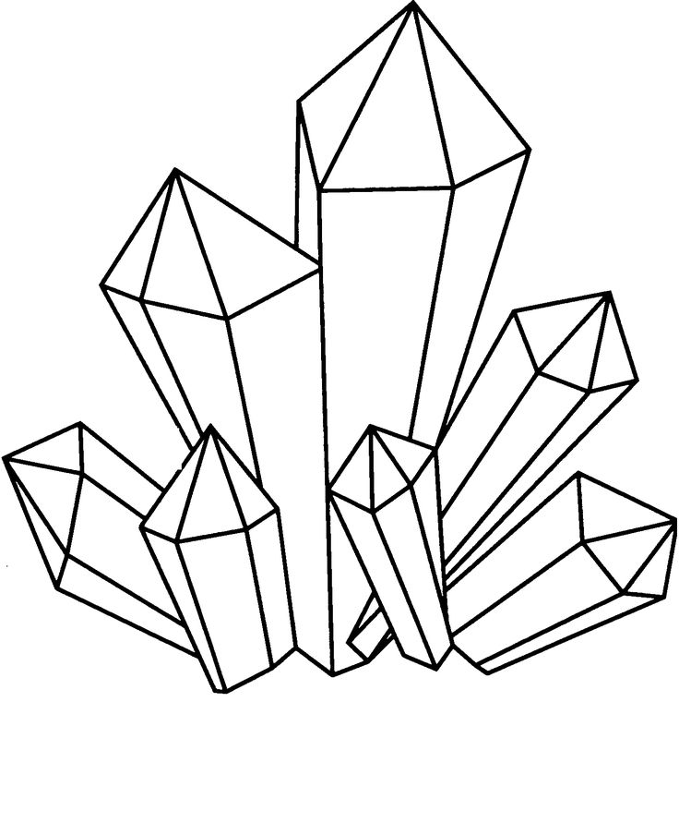
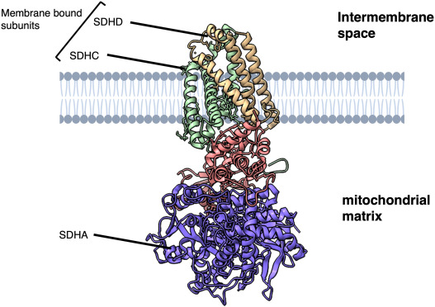
X-Ray Crystallography
Advantages:
Not limited by sample molecular weight
High resolution
Disadvantages:
Requires sample to be crystalized (time consuming + challenging)
Especially for large, complex or membrane-embedded proteins
Represents static form of protein
Phase problem
Mediated by Molecular Replacement
Notes:
Advantages:
There are little limitations on the sample’s molecular weight
You can retrieve high resolution structural data
Disadvantages
Requires the sample to be crystallized which is difficult and time consuming AND limits the samples you can use
For example it is hard to crystalize large, complex proteins or membrane-embedded proteins. For a secreted antigen this could be fine, but for looking at a membrane tethered antigen for example this technique may be harder to apply.
Because you crystalize the structure, it also represents a static crystalized form of the protein (may not be exactly relevant to how the shape of a protein can be dynamic in a living system)
There is also a phase problem that can arise with this technique because during diffraction, you record the amplitude of diffracted X-rays but not their phases. However, molecular replacement can be used to fill in the holes in this information by using previously collected structure data to fill in gaps.
https://www.technologynetworks.com/analysis/articles/key-techniques-in-structural-biology-their-strengths-and-limitations-370666

Slide 29
Cryoelectron Tomography/ Subtomogram
Advantages:
Closer to native state (fast-freezing means native structures are well preserved)
More dynamic view of the structure
allows for time-resolved imaging that capture structural changes over time
Allows for study of large, flexible, membrane associated complexes
Disadvantages:
Large datasets that are computationally demanding
Generally lower resolution
although improvements have been made towards near-atomic-level resolution (new technology and averaging → 2-5 Å )
Notes:
Advantages:
Since there is no crystallization and using freezing instead samples using this technique may be closer to their native state
It also allows for a more dynamic view of protein structure rather than the static view of X-ray Crystallography
Also because there is no crystallization, this technique can be used to study larger, flexible or membrane associated structures
Disadvantages:
The output of this technique is computationally demanding (may require skill or good computing power to analyze)
In general this technique has lower resolution, although recent improvements have been made towards the resolution of X-ray Crystallography
https://www.creative-biostructure.com/comparison-of-crystallography-nmr-and-em_6.htm
https://www.technologynetworks.com/analysis/articles/cryo-electron-microscopy-principle-strengths-limitations-and-applications-377080
https://www.ncbi.nlm.nih.gov/pmc/articles/PMC8228724/ (improvements in resolution)

Slide 30
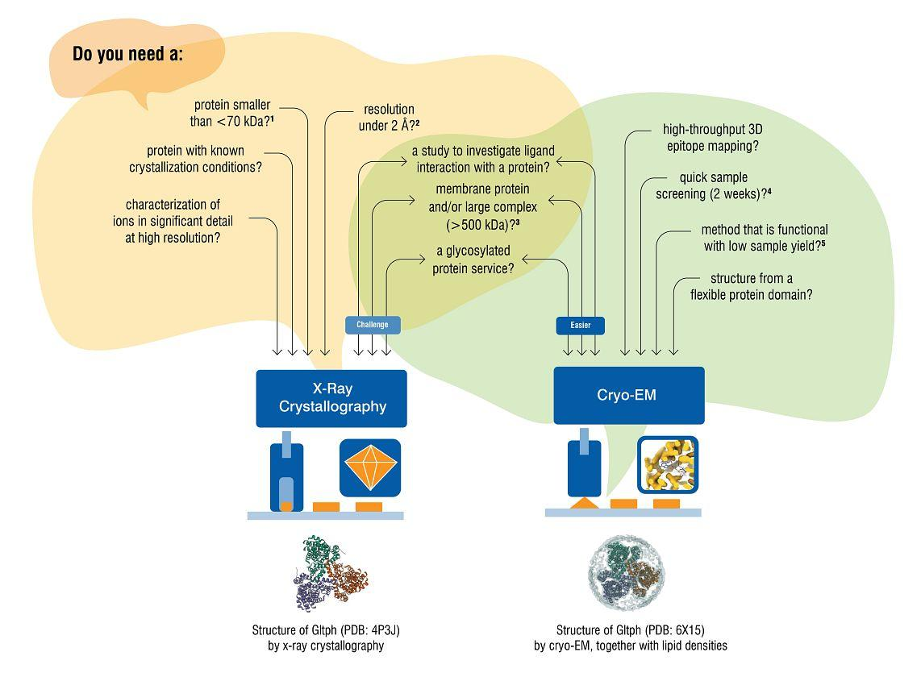
When to use these techniques
→ using both can illuminate areas of low resolution while maintaining information on more native-like states of the structure
Notes:
Much of the decisions to use either method will be decided by the sample you are looking at (the size, flexibility, ease of crystallization, need for a dynamic view, etc)
Without these limitations however, researchers (like from this paper) can use both methods together to illuminate the structure at high resolution (fill in the blanks or areas of lower resolution from one method with data from another) and can determine a steady and more native-like state of the structures.
https://www.criver.com/resources/x-ray-crystallography-or-cryo-em-which-solution-should-you-choose#:~:text=X%2Dray%20crystallography%20can%20obtain,therefore%20be%20an%20easier%20option.

Slide 31
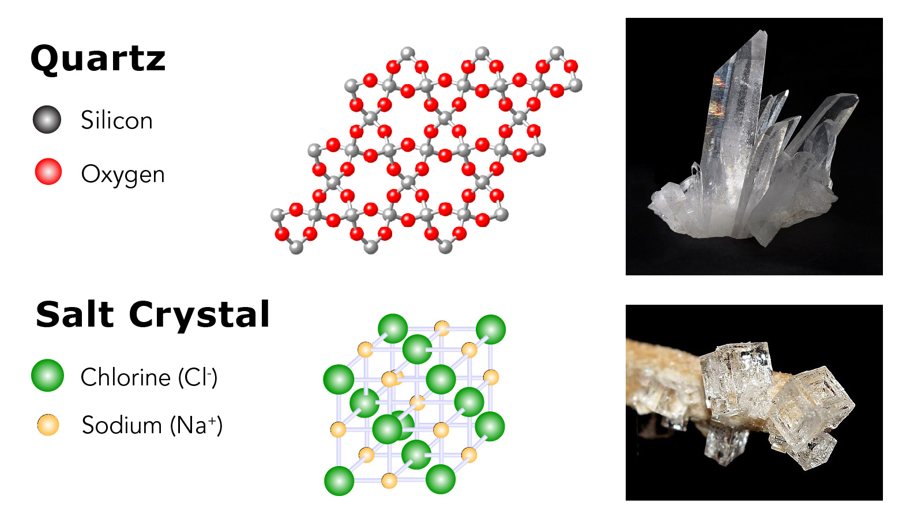
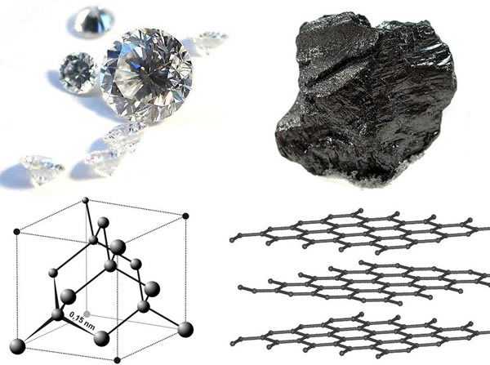
More X-ray Crystallography Applications
Chemistry
Pharmacology
Materials Science
Geology and Mineralogy
Forensic Science
Notes:
We know the main function is: to determine structure of proteins and biological macromolecules
This is how it is used to develop drugs and improve drug delivery
This was used in the discovery of the double helix structure in 1953
Chemistry:
Shows us arrangement of atoms within molecules, helps us identify unknown compounds, verify the structure of newly synthesized molecules, and determine intermediate and transition states of chemical reactions
Pharmacology:
Used to look at different crystal forms (polymorphs) of the same compound which can have varying solubility and stability, affecting the drug's efficacy and shelf-life.
Materials science:
Has applications in crystal engineering and semiconductor research. Can tell us about conductivity, magnetism, gas separation abilities and optical behaviors which is crucial for the design and production of electronic components like transistors and solar cells.
Geology and Mineralogy :
Geologists use X-ray crystallography to determine the atomic structure of minerals, helping to understand their properties, formation conditions, and origins.
Forensic Science:
identify unknown substances in forensic investigations, such as determining the composition of suspicious powders or crystalline substances

Slide 32
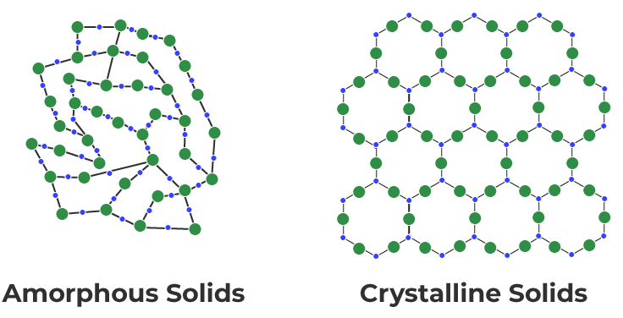
More Cryoelectron Tomography/Subtomogram
Applications
Nanotechnology and Nanomaterials
Synthetic Biology
Materials Science
Environmental Science
Food Science
Notes:
Again, we know CE tomography in the context of this paper is to study large protein complexes and intact structure of viruses like HIV with extremely high resolution. An important distinction between Xray crystallography and Cryo-ET is Cryo-ET can be used to look at amorphous solids, not just crystalline solids. But can also be used for.
Nanotech:
Shows three-dimensional structure of nanoparticles, nanocrystals, and other nanoscale materials helps us understand how these materials are structured at the atomic level, providing insights about properties and behaviors.
W hich is crucial for applications in energy storage, catalysis, material design, electronics, optics, and other technological fields.
Synthetic Biology:
Shows structural analysis of engineered biological systems or synthetic assemblies, such as artificial membranes or molecular machines, which are used in bioengineering and nanotechnology.
Materials Science:
The technique is used to study soft polymer materials or amorphous materials, such as hydrogels and biopolymers in their hydrated state. Studying amorphous materials is important in fields like glass technology, metallurgy, and ceramics.
Cryo-ET also helps in the 3D imaging of metal alloys, revealing how atomic structures form and evolve under different environmental conditions, which can be used to design stronger and more resilient materials.
Environmental Science:
Shows structural interactions of microorganisms with their environments, helping to understand how microbes contribute to biogeochemical cycles (e.g., carbon, nitrogen cycles).
Soil particle and mineral imaging imaging is valuable for studying soil formation, erosion, and the interactions of minerals with organic materials.
Food Science:
Cryo-ET is used to study the microstructure of food emulsions, gels, and colloidal suspensions, which are important in understanding food texture, stability, and processing.
One example is with ice cream and dairy products, helps to visualize the distribution and formation of ice crystals and fat structures which contributes to the improvement of texture and quality of the food.
Side note if needed:
Colloid definition: a homogeneous noncrystalline substance consisting of large molecules or ultramicroscopic particles of one substance dispersed through a second substance. Colloids include gels, sols, and emulsions; the particles do not settle, and cannot be separated out by ordinary filtering or centrifuging like those in a suspension.
Emulsion definition: a fine dispersion of minute droplets of one liquid in another in which it is not soluble or miscible.

Slide 33
Thank you!

Slide 34
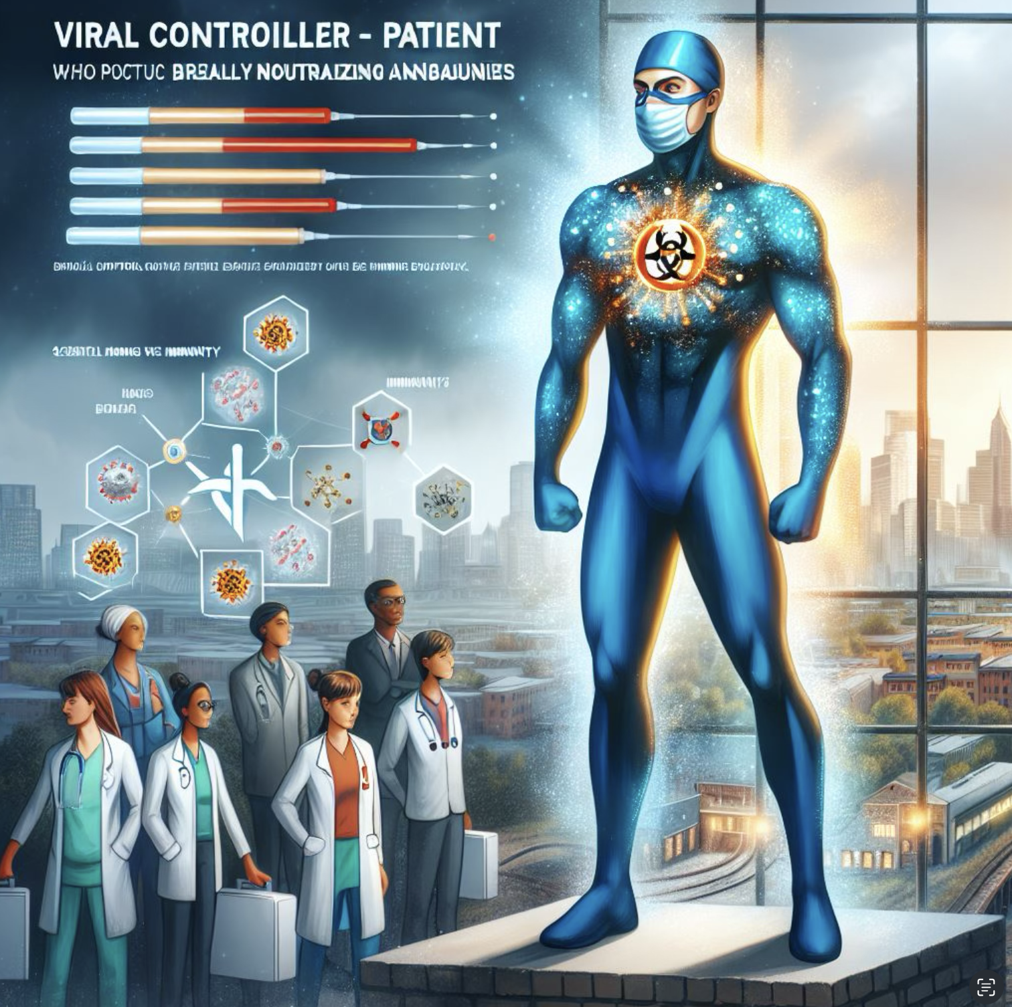

AI Generated Images :)

Slide 35
Citations
“Basics of Photogrammetry.” Geodetic Systems, Inc, www.geodetic.com/basics-of-photogrammetry/.
Hall, David H., et al. “Modern electron microscopy methods for C. elegans.” Methods in Cell Biology, 2012, pp. 93–149, https://doi.org/10.1016/b978-0-12-394620-1.00004-7.
Vijayakrishnan, Swetha, et al. “In situ structure of virus capsids within cell nuclei by correlative light and cryo-electron tomography.” Scientific Reports, vol. 10, no. 1, 19 Oct. 2020, https://doi.org/10.1038/s41598-020-74104-x.
Freund, Natalia T., et al. “Coexistence of potent HIV-1 broadly neutralizing antibodies and antibody-sensitive viruses in a viremic controller.” Science Translational Medicine, vol. 9, no. 373, 18 Jan. 2017, https://doi.org/10.1126/scitranslmed.aal2144.
“Cryo-Electron Tomography Sample Data.” Thermo Fisher Scientific - US, www.thermofisher.com/us/en/home/electron-microscopy/life-sciences/cryo-tomography/sample-data.html. Accessed 19 Sept. 2024.
“Cryo-Electron Tomography Technology.” Thermo Fisher Scientific - US, www.thermofisher.com/us/en/home/electron-microscopy/life-sciences/cryo-tomography/workflow.html#:~:text=Cryo%2Delectron%20tomography%20has%20been,cells%20and%20large%20tissue%20samples. Accessed 19 Sept. 2024.
Sibert, Bryan S., et al. “Micropatterning transmission electron microscopy grids to direct cell positioning within whole-cell cryo-electron tomography workflows.” Journal of Visualized Experiments, no. 175, 13 Sept. 2021, https://doi.org/10.3791/62992.
“Cryo EM Tomography.” YouTube, www.youtube.com/watch?v=frgjc-ZNhOY. Accessed 19 Sept. 2024.
Regents of the University of California. “UCSF Chimera an Extensible Molecular Modeling System.” UCSF Chimera Home Page, 2018, www.cgl.ucsf.edu/chimera/.

Slide 36
Citations cont.
RELION developer team. “Unsupervised 3D Classification.” Unsupervised 3D Classification - RELION Documentation, relion.readthedocs.io/en/release-3.1/SPA_tutorial/Class3D.html. Accessed 30 Sept. 2024.
Zost, S.J., Gilchuk, P., Chen, R.E. et al. Rapid isolation and profiling of a diverse panel of human monoclonal antibodies targeting the SARS-CoV-2 spike protein. Nat Med 26, 1422–1427 (2020). https://doi.org/10.1038/s41591-020-0998-x
Asano, Shoh, et al. “In situ cryo-electron tomography: A post-reductionist approach to structural biology.” Journal of Molecular Biology, vol. 428, no. 2, Jan. 2016, pp. 332–343, https://doi.org/10.1016/j.jmb.2015.09.030.
“What Is the Difference between Cryo-EM and Cryo-Et?” Delmic Microscopy Blog, blog.delmic.com/what-is-the-difference-between-cryo-em-and-cryo-et. Accessed 19 Sept. 2024.
Sébastien Pillet; Spin-crossover materials: Getting the most from x-ray crystallography. J. Appl. Phys. 14 May 2021; 129 (18): 181101. https://doi.org/10.1063/5.0047681
Gong, Y., Gu, T., Ling, L., Qiu, R., & Zhang, W. (2022). Visualizing hazardous solids with cryogenic electron microscopy (Cryo-EM). Journal of Hazardous Materials, 436, 129192–129192. https://doi.org/10.1016/j.jhazmat.2022.129192
Kupikowska-Stobba, Barbara, Jacek Domagała, and Mirosław M. Kasprzak. 2024. "Critical Review of Techniques for Food Emulsion Characterization" Applied Sciences 14, no. 3: 1069. https://doi.org/10.3390/app14031069
Do, G., Sase, S., Kobayashi, R., Sato, M., Bae, Y., Maeda, T., Ueno, S., & Araki, T. (2020). Determining the internal structure of ice cream using cryogenic microtome imaging and x-ray computed tomography. Japan Journal of Food Engineering, 21(3), 113–121.

